Slide 1
Online Job Portal
MOVALIYA RAJAT (CE069)
MONAPARA JAYDEEP (CE067)
AKASH PADHIYAR (CE076)

Slide 2
BRIEF DEFINATION

Slide 3
This system is designed to maximize the efficiency of connecting job seeker and job provider companies easily by providing online platform with authentication, which would otherwise be done manually
Here, They can search complete depth information about each other and join
It reduces physical cost of finding jobs and aspirants
System will provide an automatized recommendation of jobs which will reduce the job seeker’s task to find jobs.

Slide 4
Cont.
Job Provider Can
Post a job
Search other companies and job seeker by its name, location
Can also search companies and jobs by designation of its posted jobs
See aspirant’s profile
Select aspirants

Slide 5
Cont.
Job Seeker Can
Search other companies and job seeker by its name, location
Can also search companies and jobs by designation of its posted jobs
Apply for a job
Save a job
Refer a job to its connections
Make connections
Send request

Slide 6
Database Design in SQL Server

Slide 7
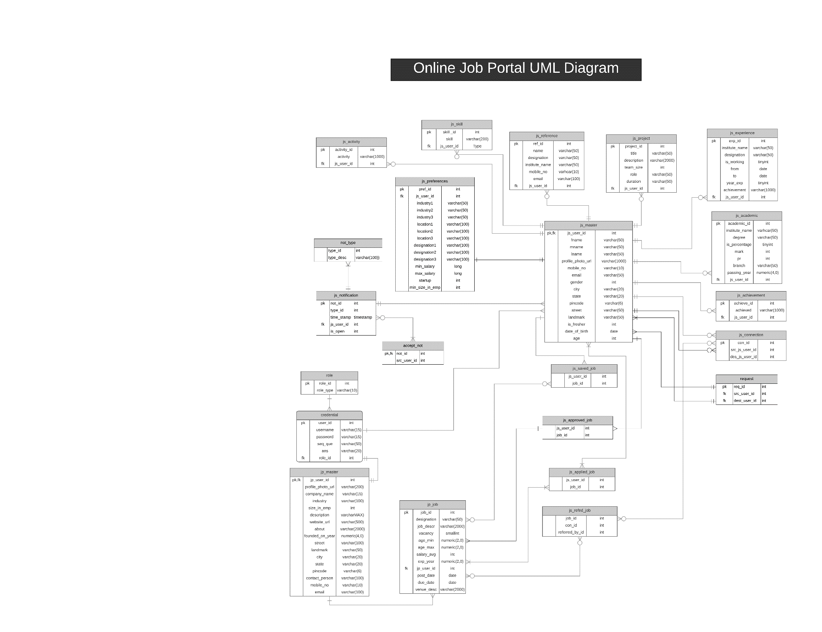
DATABASE DESIGN

Slide 8
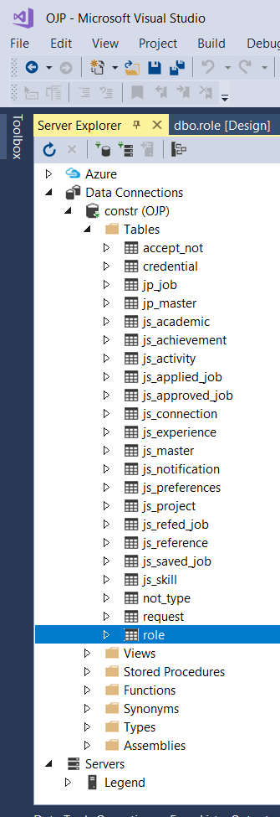
Server Explorer

Slide 9
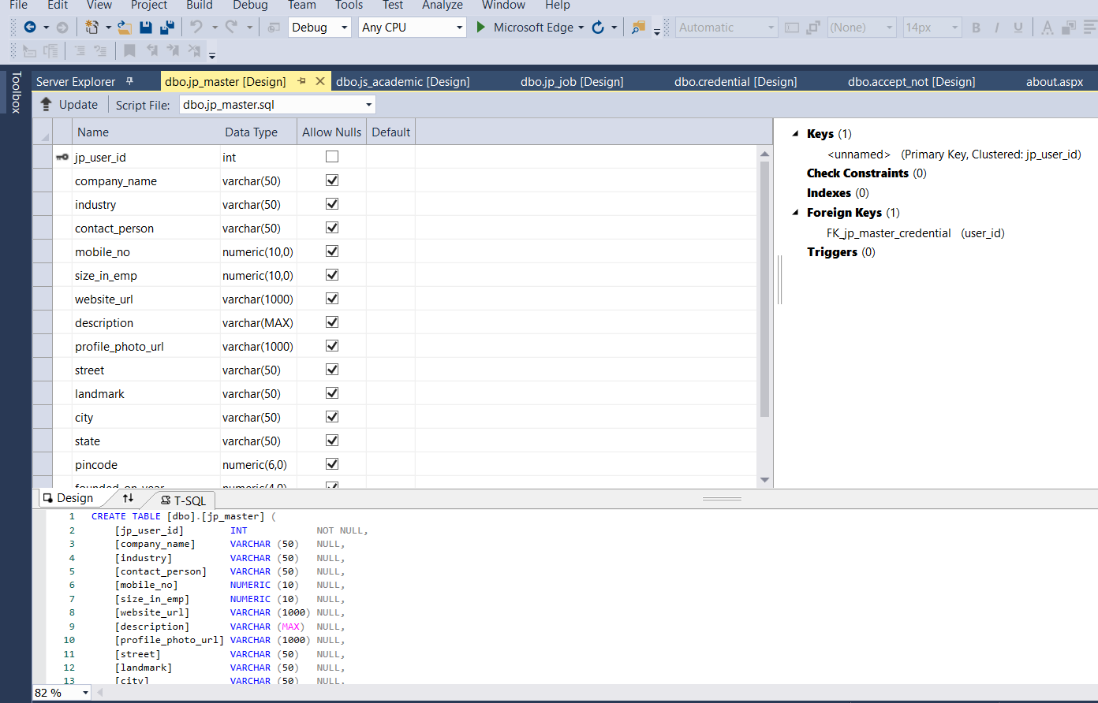
Table

Slide 10
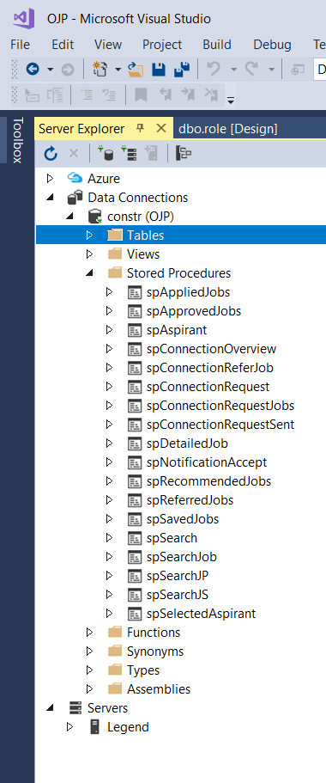
Stored Procedures

Slide 11
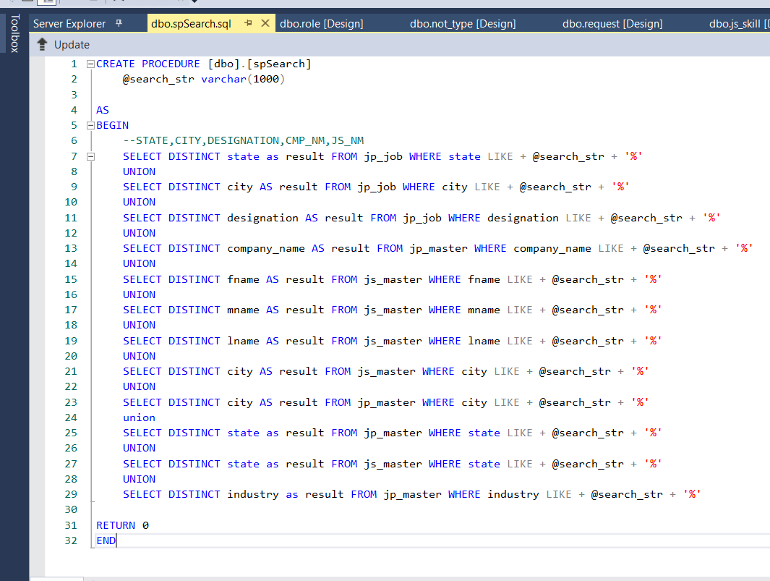
Stored Procedure

Slide 12
Description of Modules

Slide 13
General Description
All pages use ASP DataList Control to display data like saved_jobs, connections, requests, posted jobs, profile details in listed format
The pages which takes the data like mobile no, email, birthdate, year,etc. consists ASP Validator Controls to validate entered data by user

Slide 14
Login.aspx
It consists of text box username and password and button for login which redirects to job_recommended.aspx and posted_job.aspx by user’s role Job Seeker and Job Provider respectively
Also consists buttons for signup as JobSeeker or job provider and forgot password
Consists About,Contact Us tabs which redirects to about.aspx and contact_us.aspx page respectively

Slide 15
about.aspx page consists the information about this application
contact_us.aspx page consists the information about the creators and their mantors of this application
It also shows total available jobs,total job providers and total job seekers

Slide 16
job_recommended.aspx
It shows the recommended jobs as per the preferences of job seeker
Also consists menu, which consists button for saved, applied, referred & approved jobs, connections, requests, reference, profile, notifications, credentials, preferences which redirects to
job_saved.aspx, job_applied.aspx, job_referred.aspx , job_approved.aspx,connection_overview.aspx, connection_request.aspx,reference.aspx, profile_js_personal.aspx,notification_accept.aspx, profile_js_credential.aspx,profile_js_preference.aspx respectively

Slide 17
connection_request.aspx
It shows requests sent by other job seekers and consists buttons to accept or decline request and show profile of sender
It consists a menu consisting another button for sent request which redirects to connection_request_sent.aspx
connection_request_sent.aspx shows requests sent to other jobseeker and button for cancel request and and show profile of other jobseeker

Slide 18
profile_js_personal.aspx
It shows job seeker’s personal details
Also consists menu consisting buttons for academic details, skills, projects, activities, achievements, experiences of jobseeker

Slide 19
notification_accept.aspx
It shows notification of accepted requests and button to see the profile of other job seekers which redirects to profile_js_personal.aspx
Also contains menu consisting another button to see other notifications

Slide 20
search.aspx
It consists AJAX Auto Complete Extender and three buttons for searching jobs,job seekers, job providers by its name,designation,location

Slide 21
posted_job.aspx
It shows posted jobs and buttons to see not selected aspirants and selected aspirants ,details of job which redirects to aspirant.aspx, aspirant_selected.aspx, jp_job_detailed.aspx respectively
It consists a button in side panel to post new job and also a menu consisting buttons for credential and profile which redirects to profilr_jp_credential.aspx and profile_jp_company.aspx respectively
aspirant_selected.aspx and aspirant.aspx are consisting a button to see the references of aspirant

Slide 22
profie_jp_company.aspx
It shows the company details of job provider
Also consists a menu containing other buttons to see the details of contact person which redirects to profile_jp_contact_person.aspx

Slide 23
Security Aspects
Session Variables are used for security purposes and to navigate between pages
Without login no one can access any page except of login page
If anyone try to do then, It will be redirected to login page

Slide 24
Screen Shots Output

Slide 25
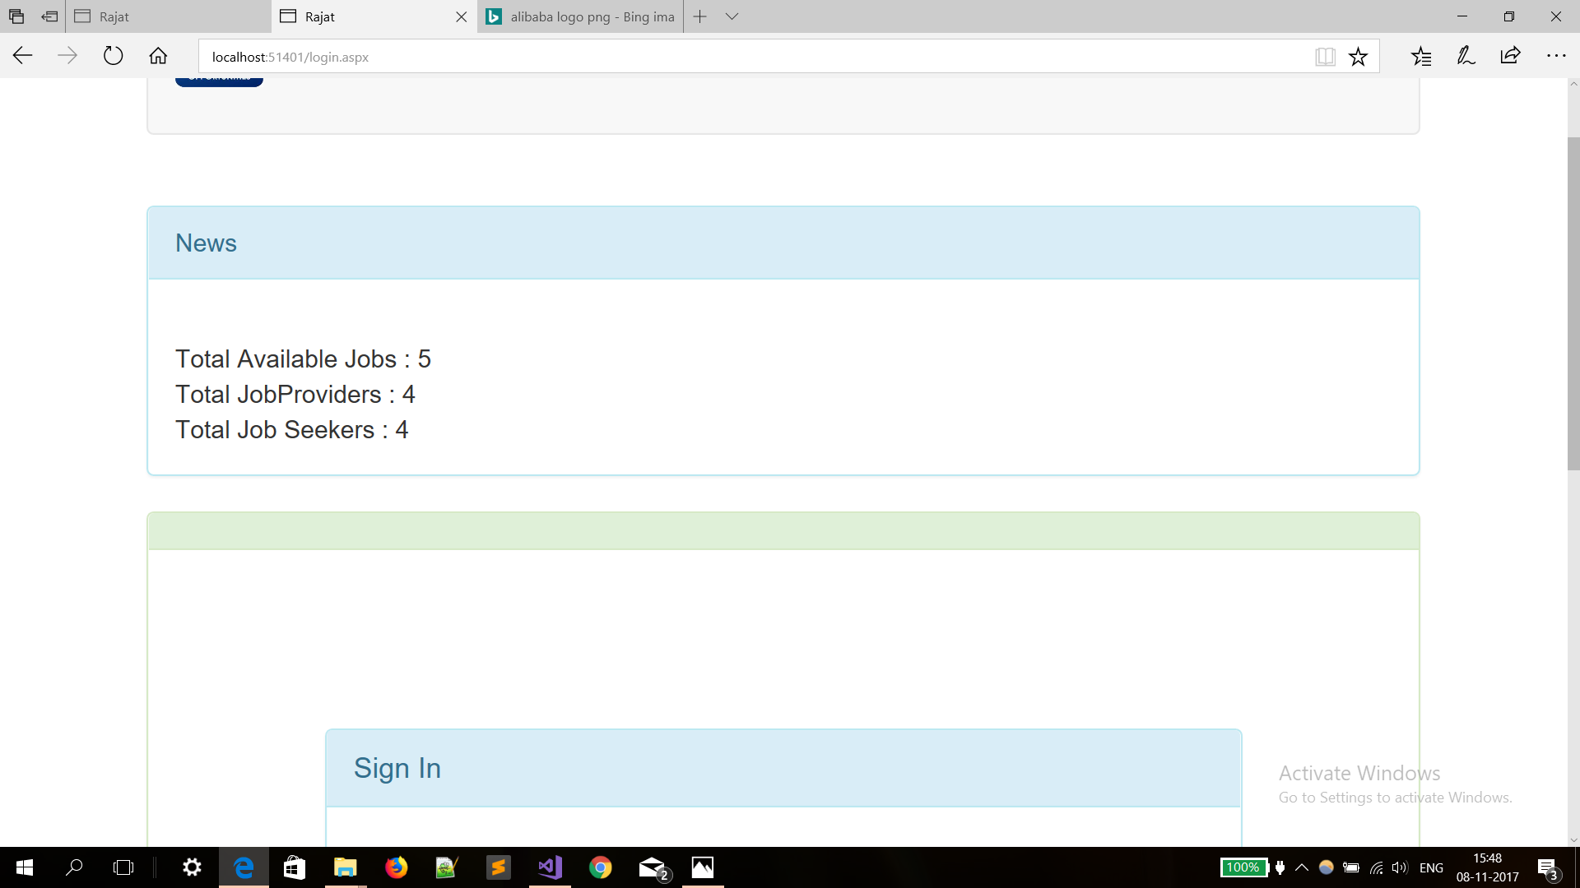

Slide 26
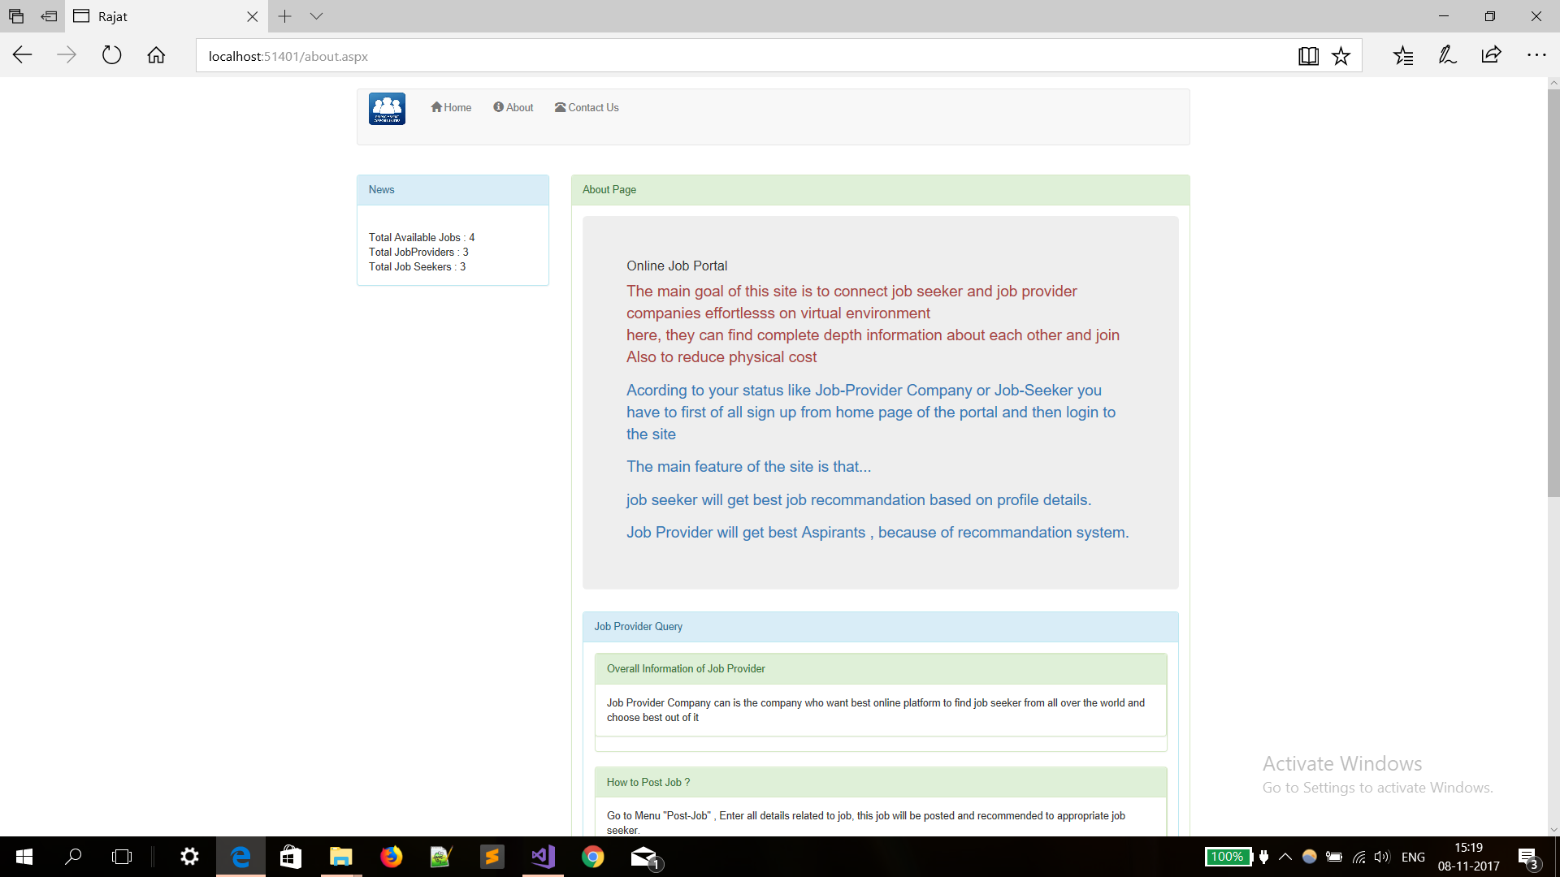

Slide 27
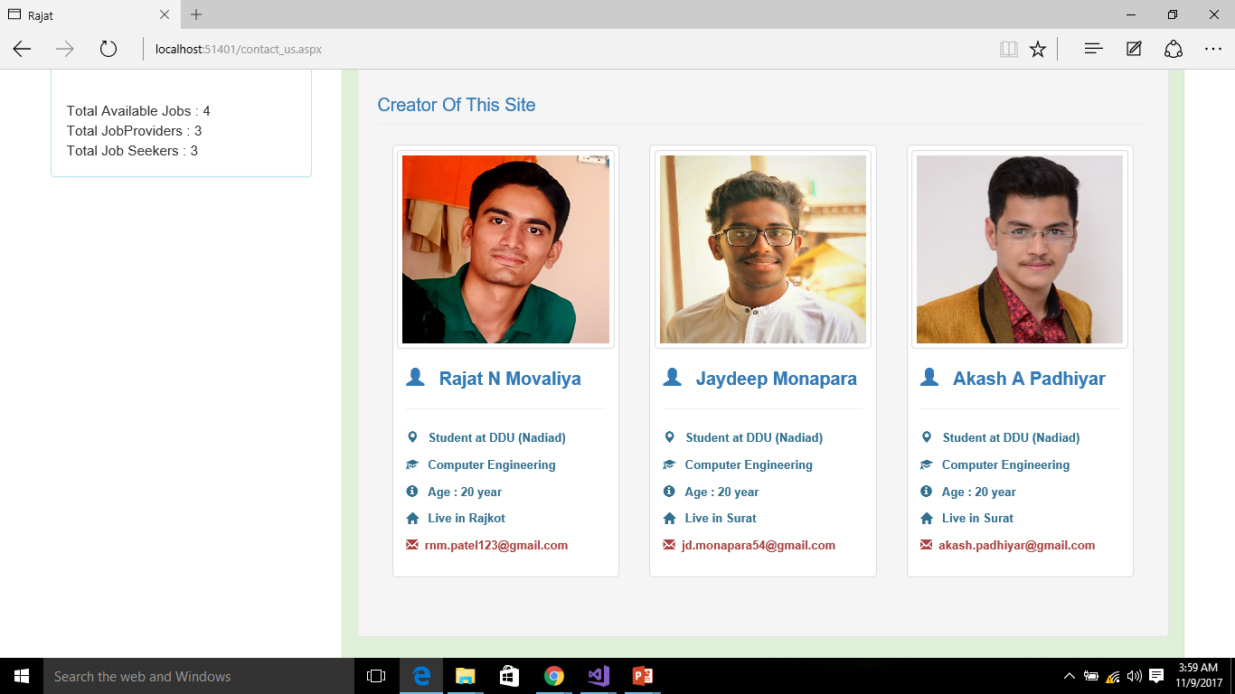

Slide 28
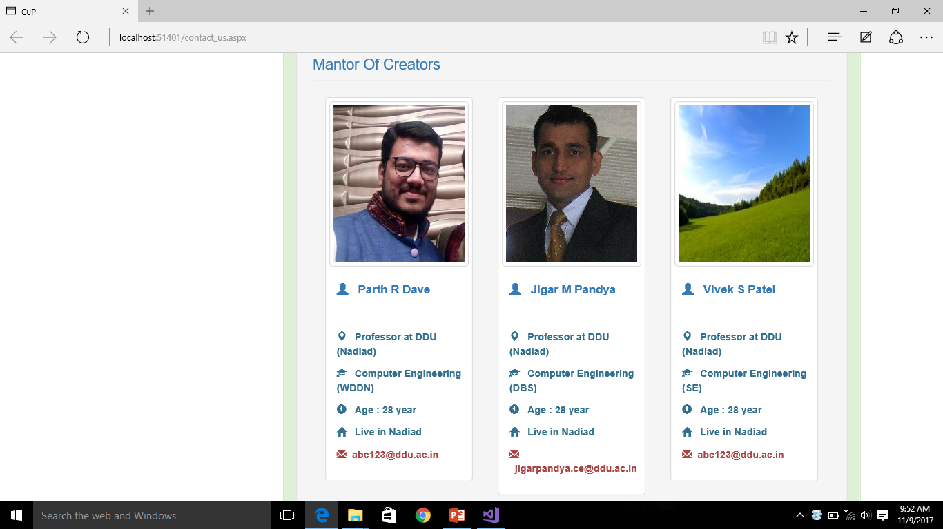

Slide 29
Login

Slide 30
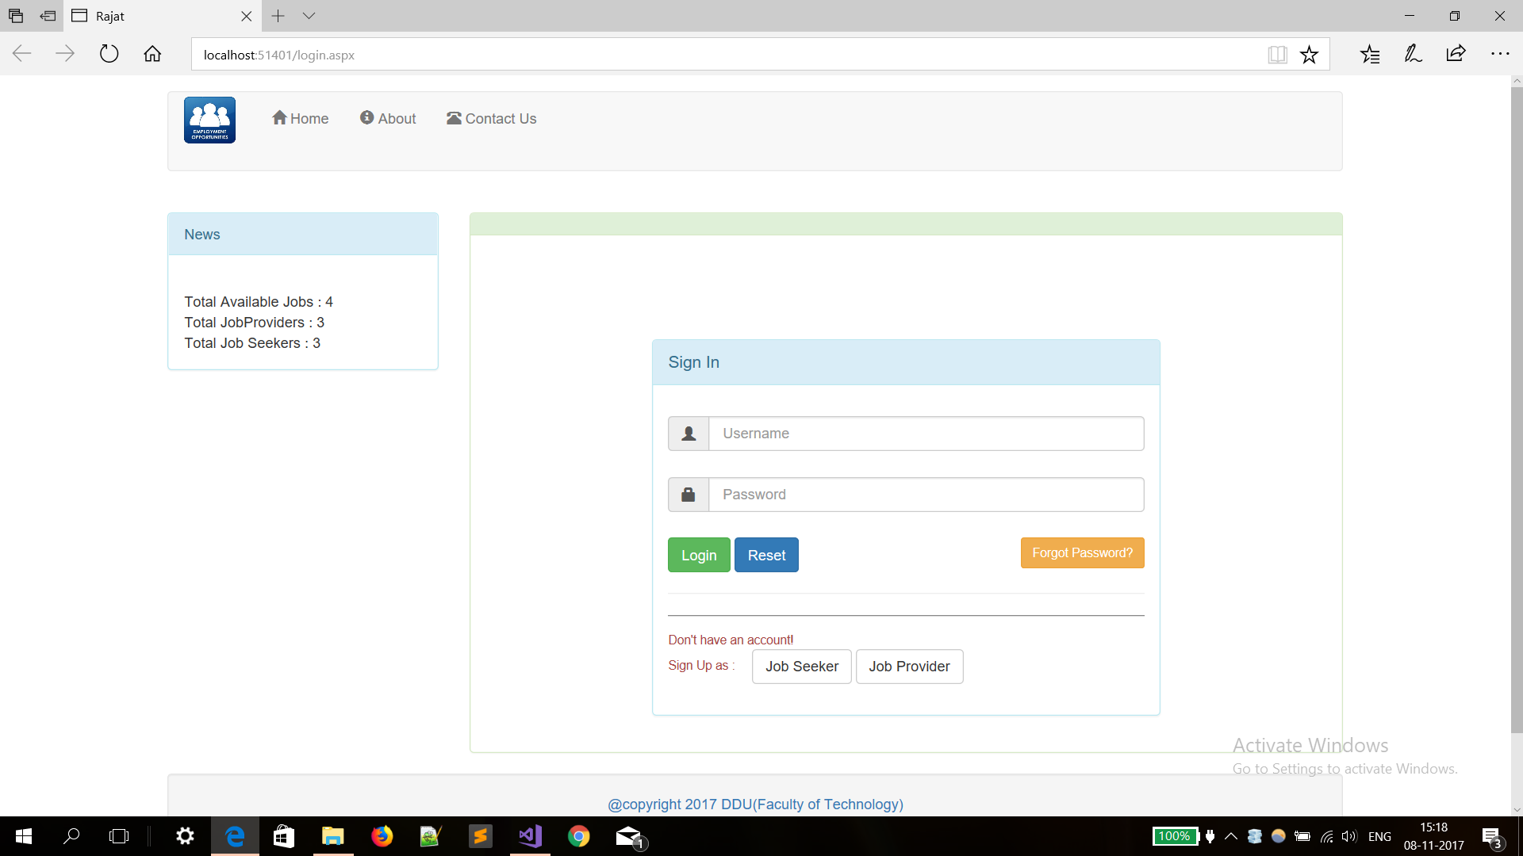

Slide 31
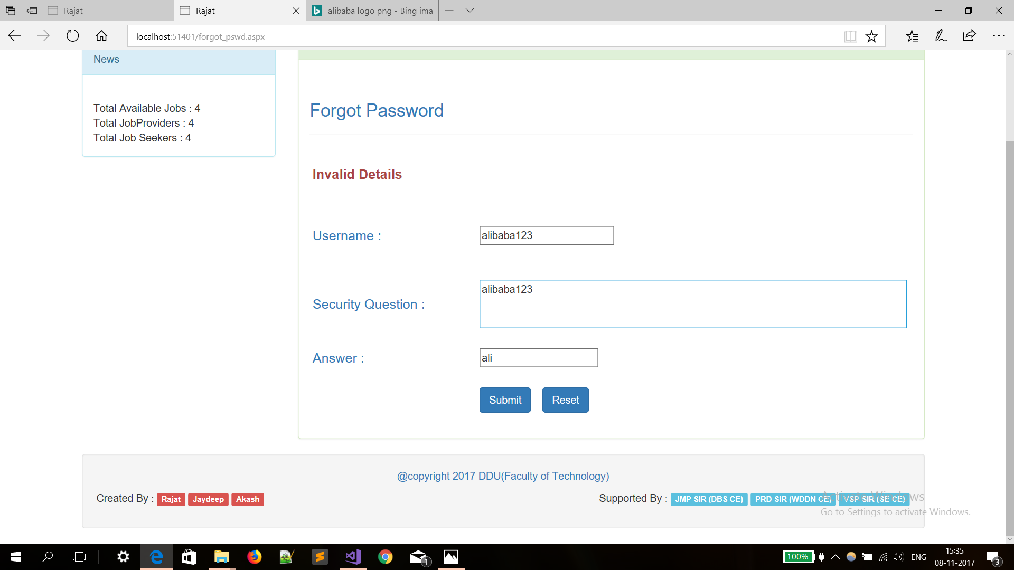

Slide 32
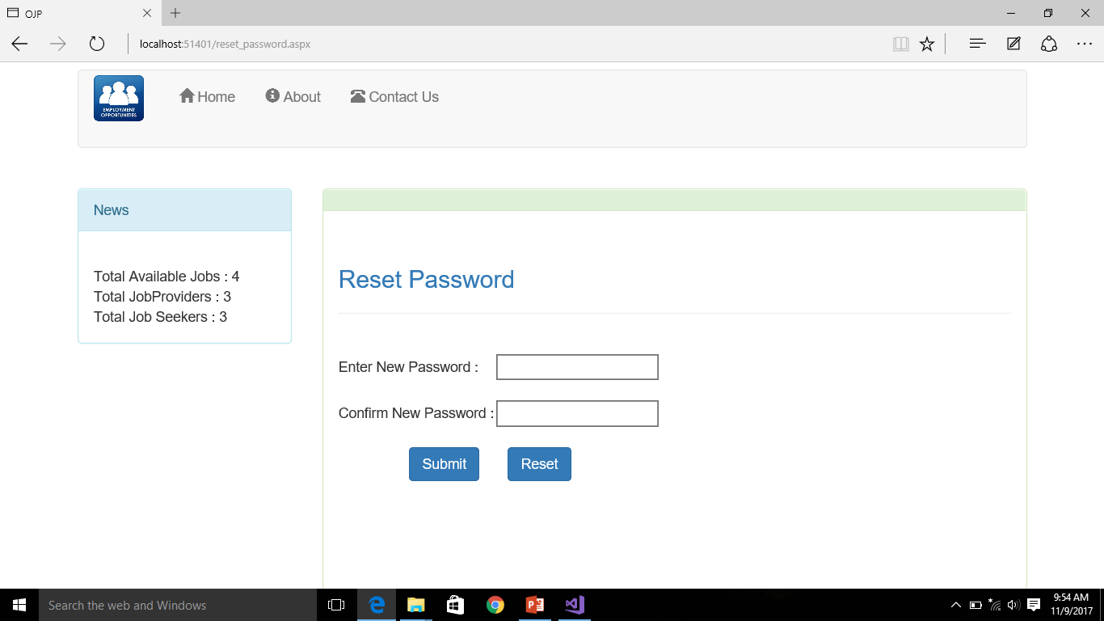

Slide 33
Search

Slide 34
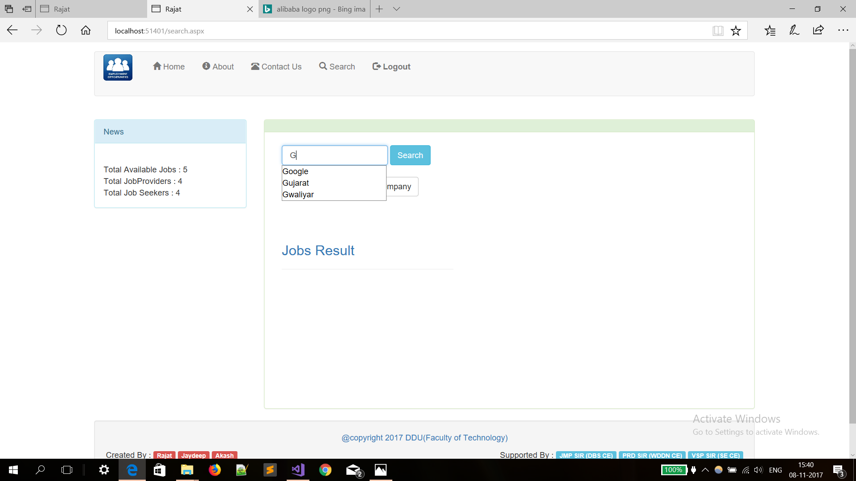

Slide 35
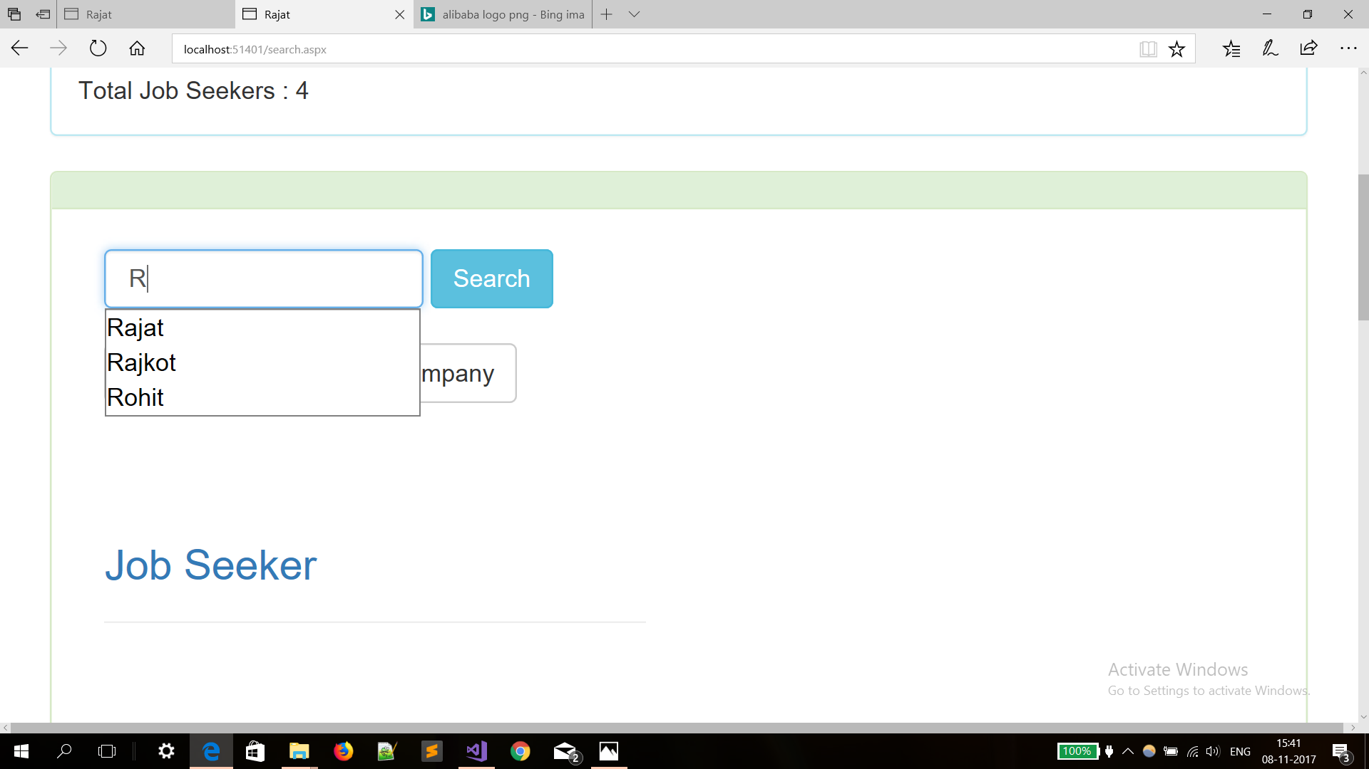

Slide 36
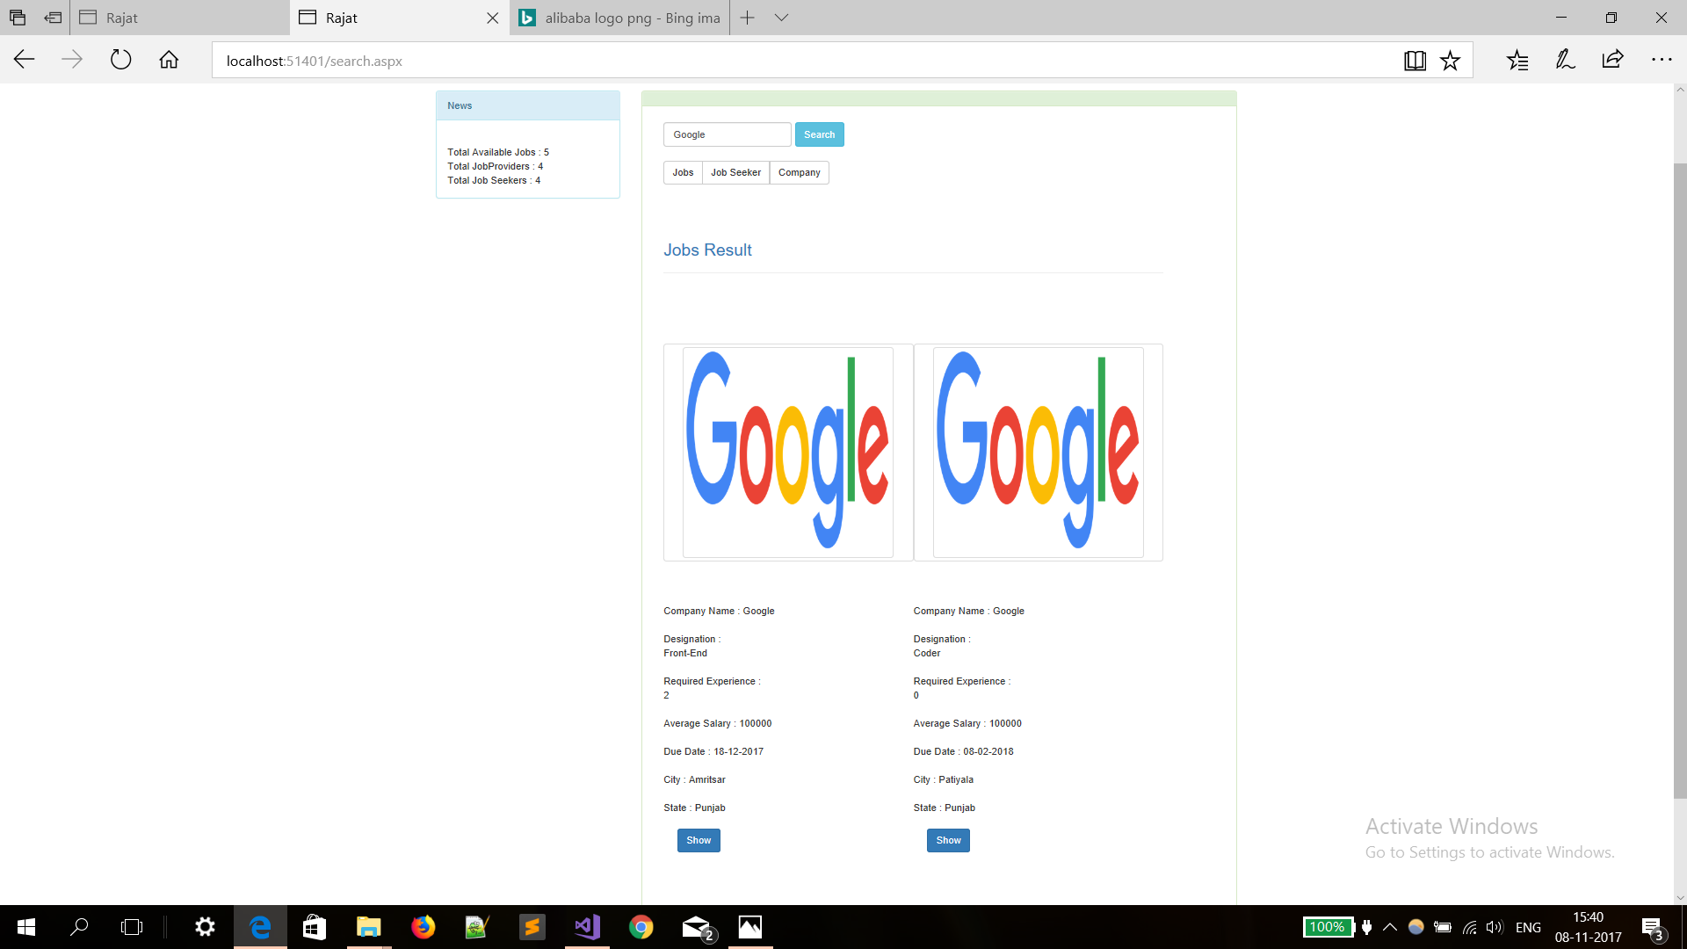

Slide 37
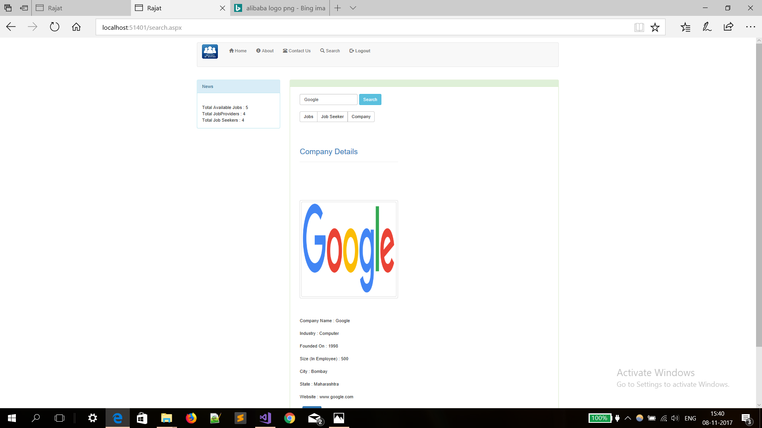

Slide 38
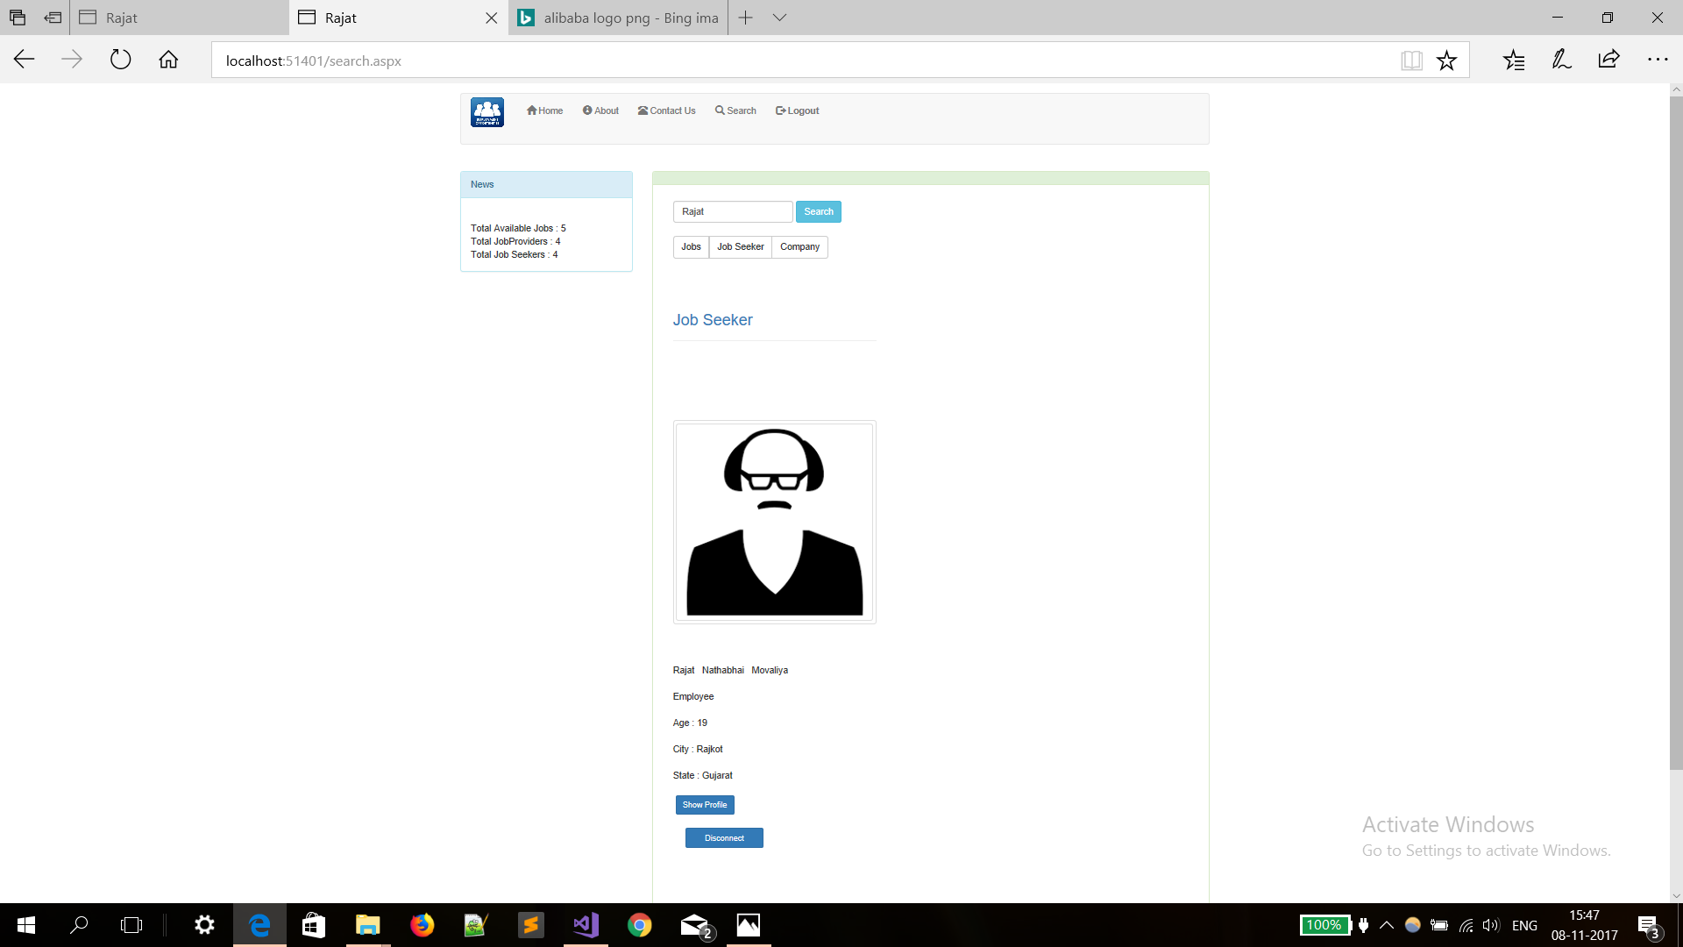

Slide 39
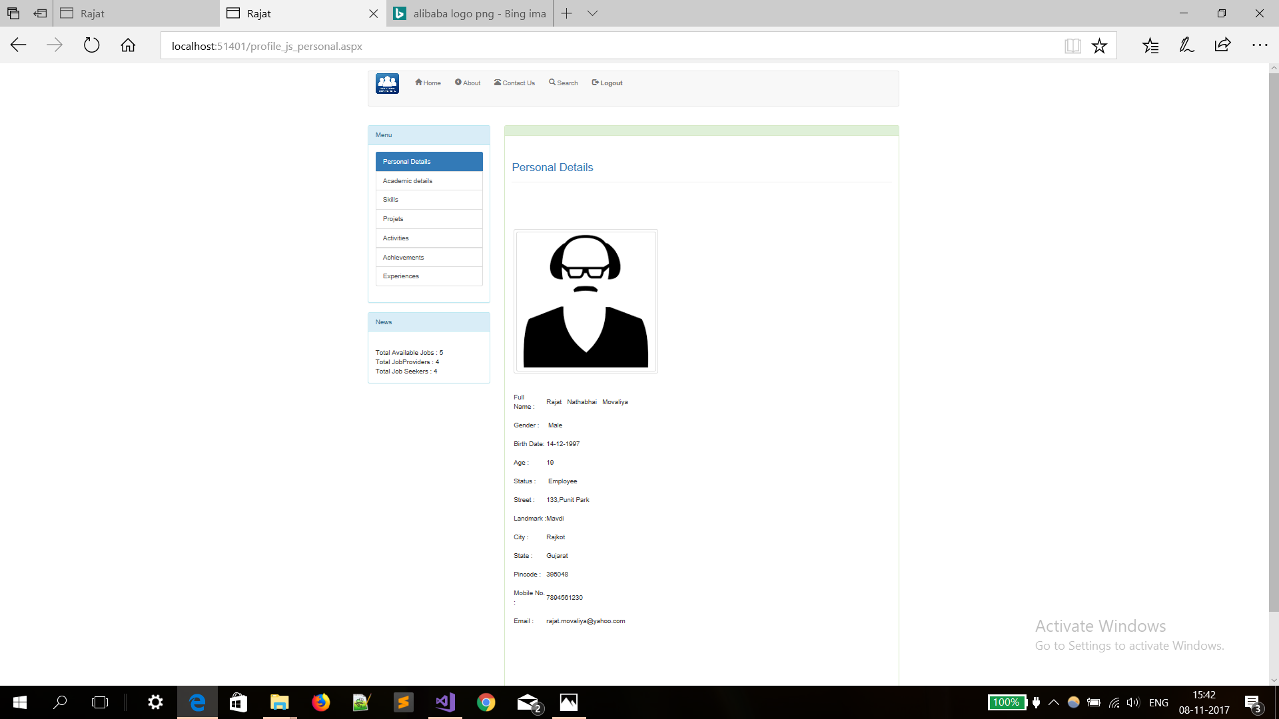

Slide 40
For Job provider

Slide 41
Sign Up

Slide 42
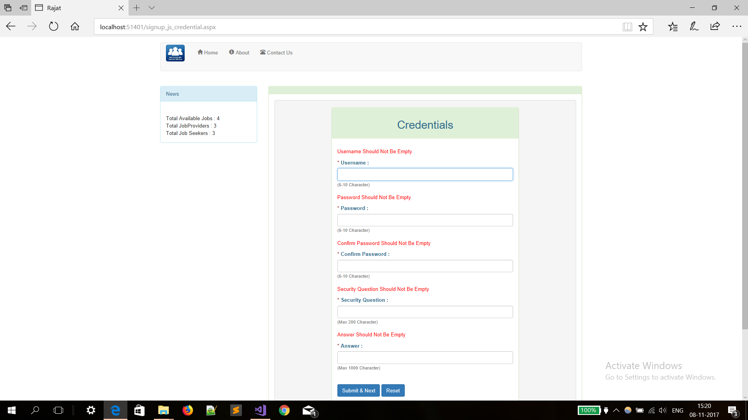

Slide 43
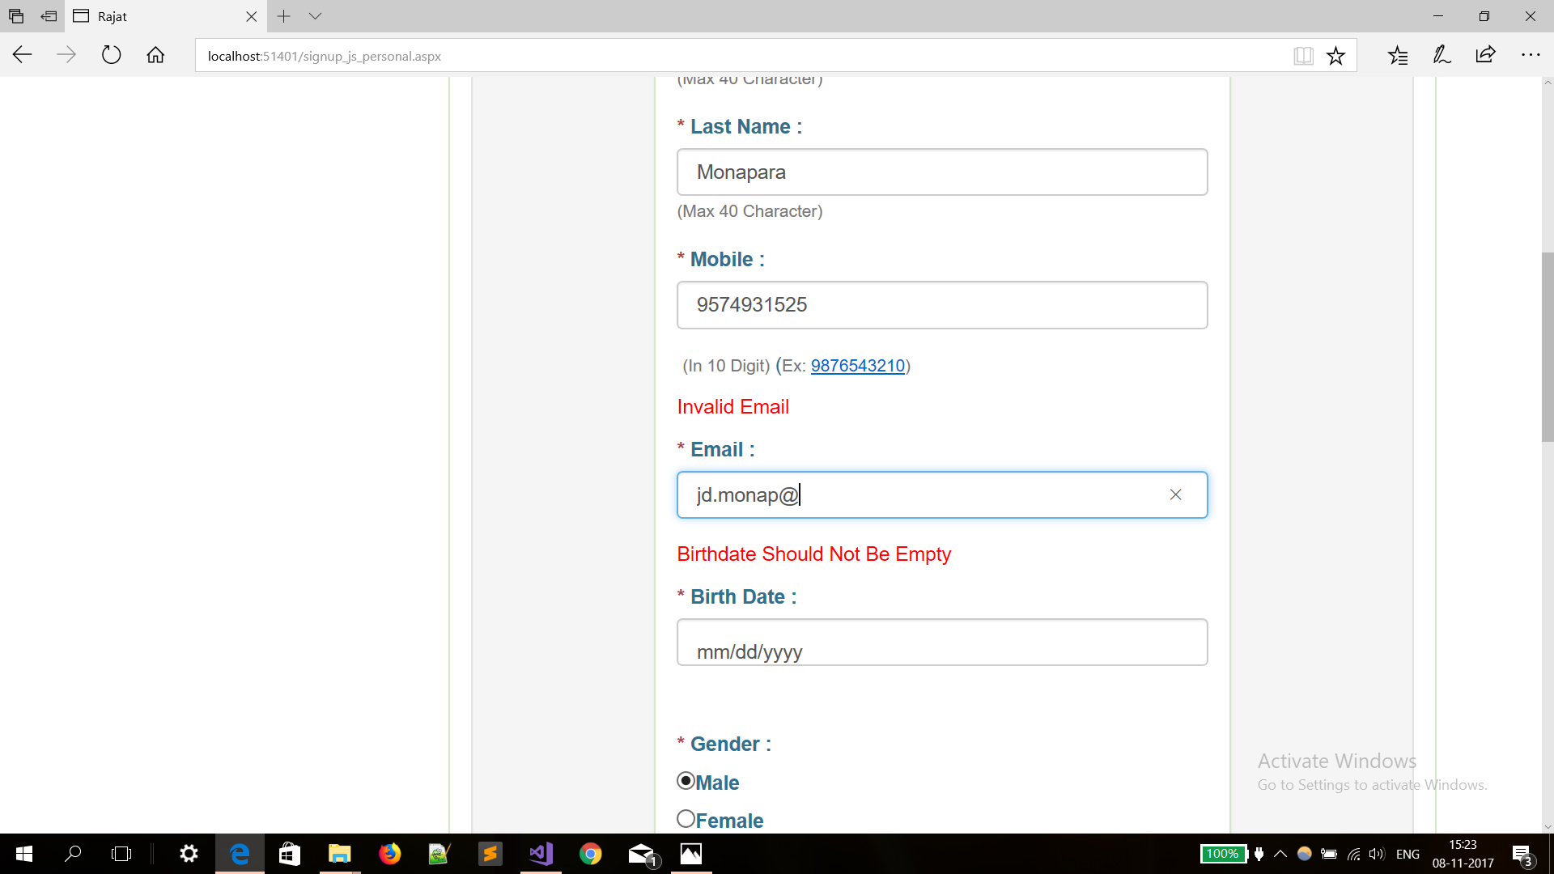

Slide 44
Dashboard

Slide 45
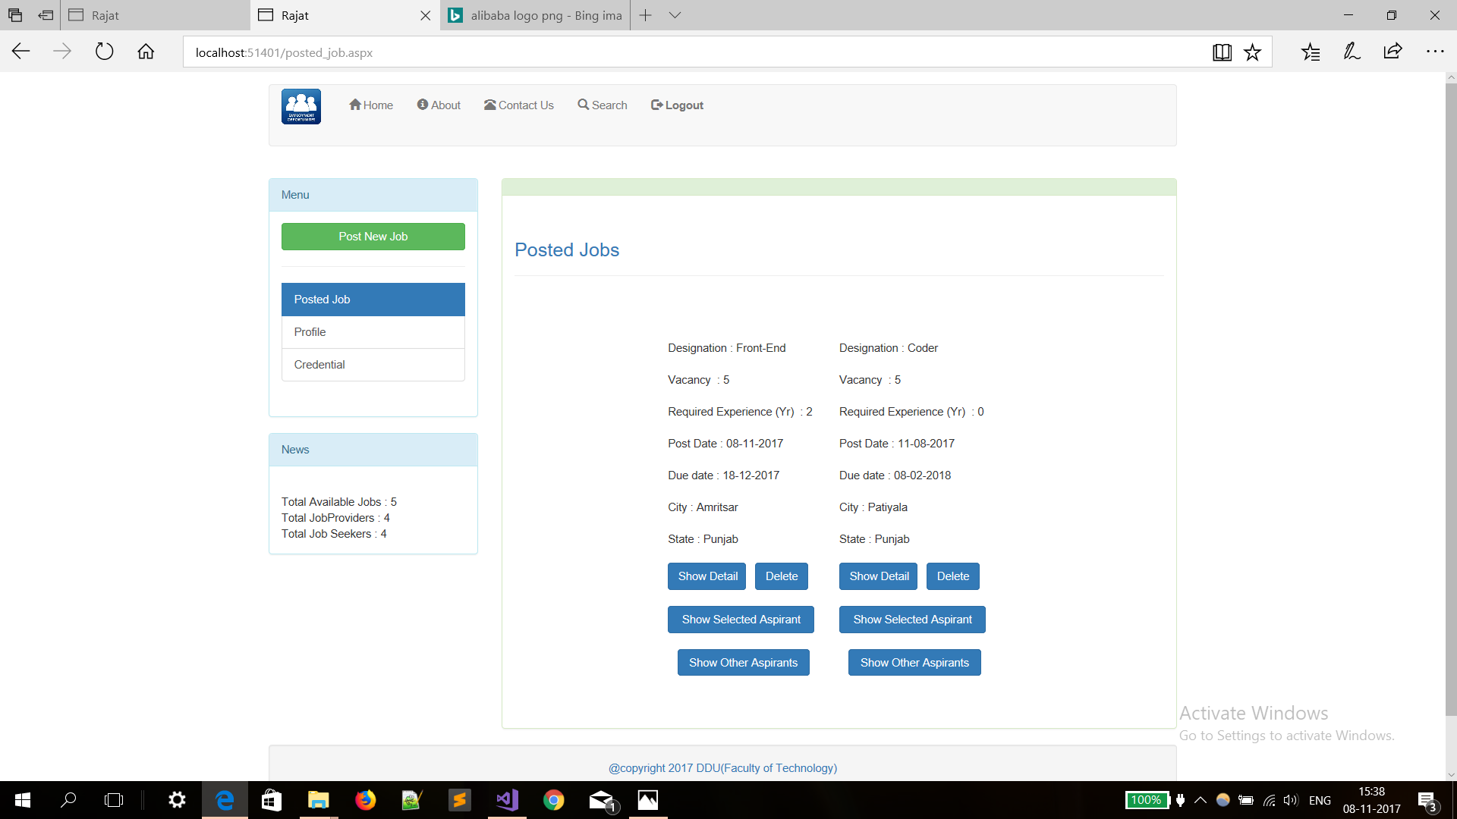

Slide 46
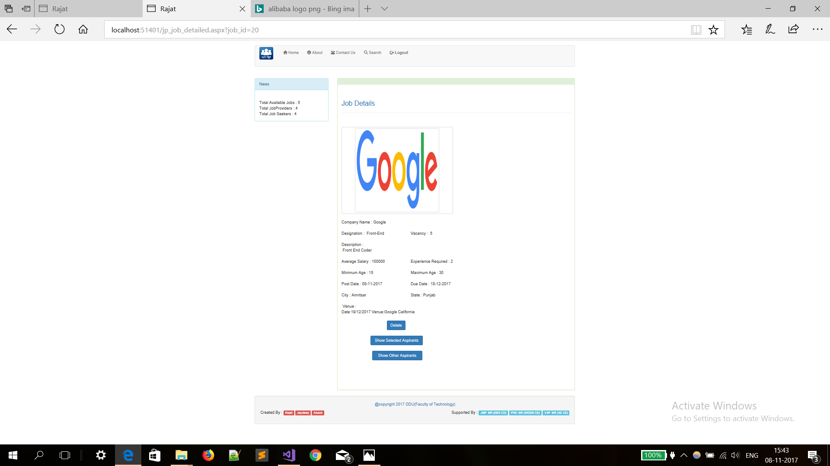

Slide 47
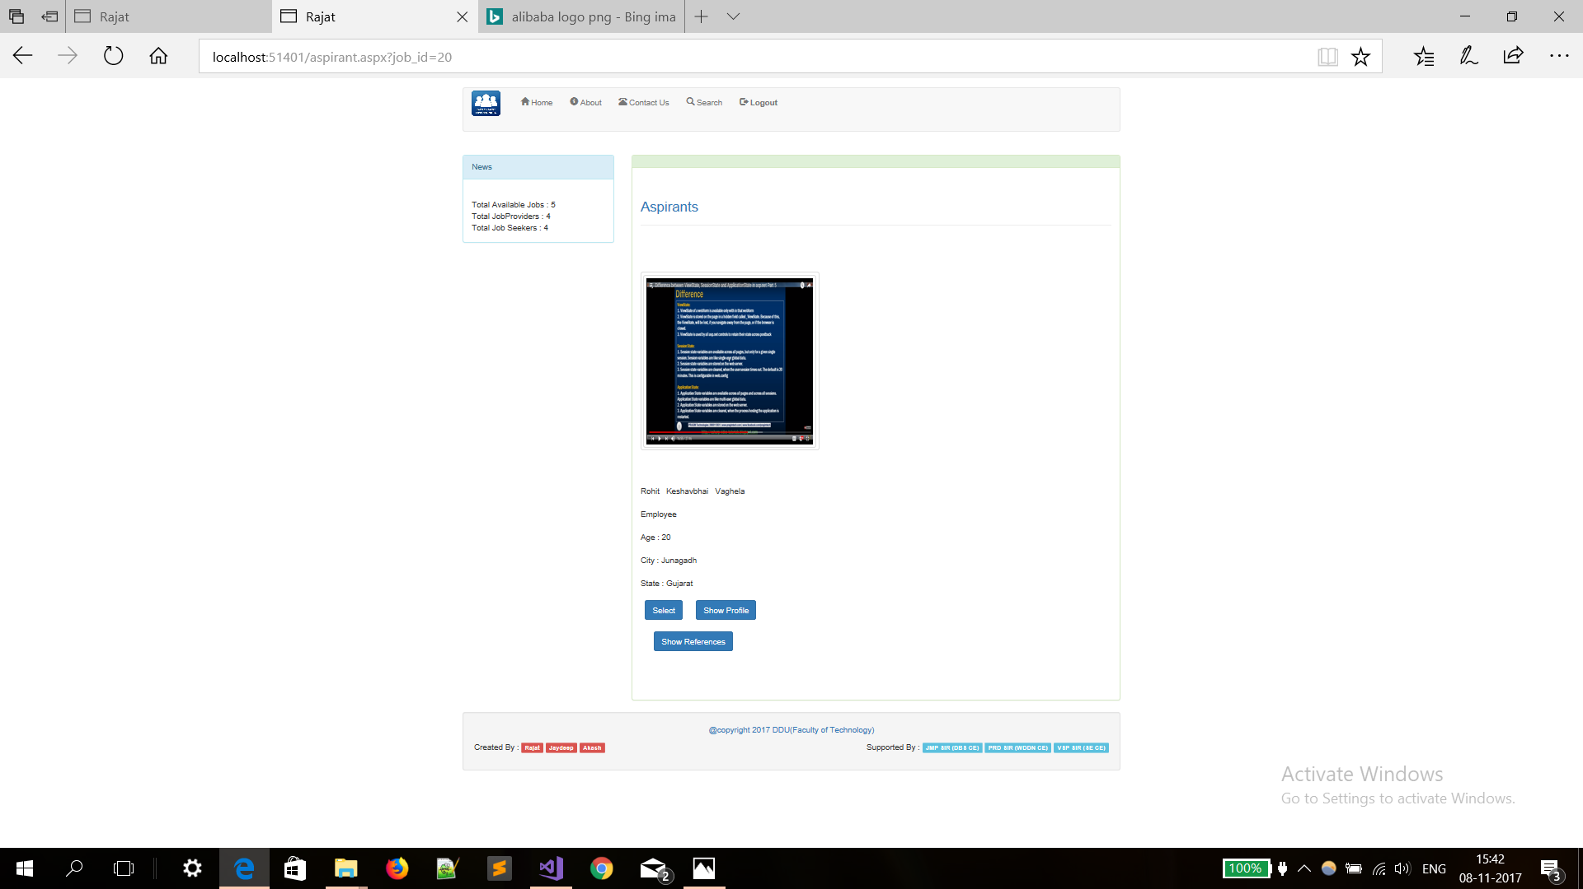

Slide 48
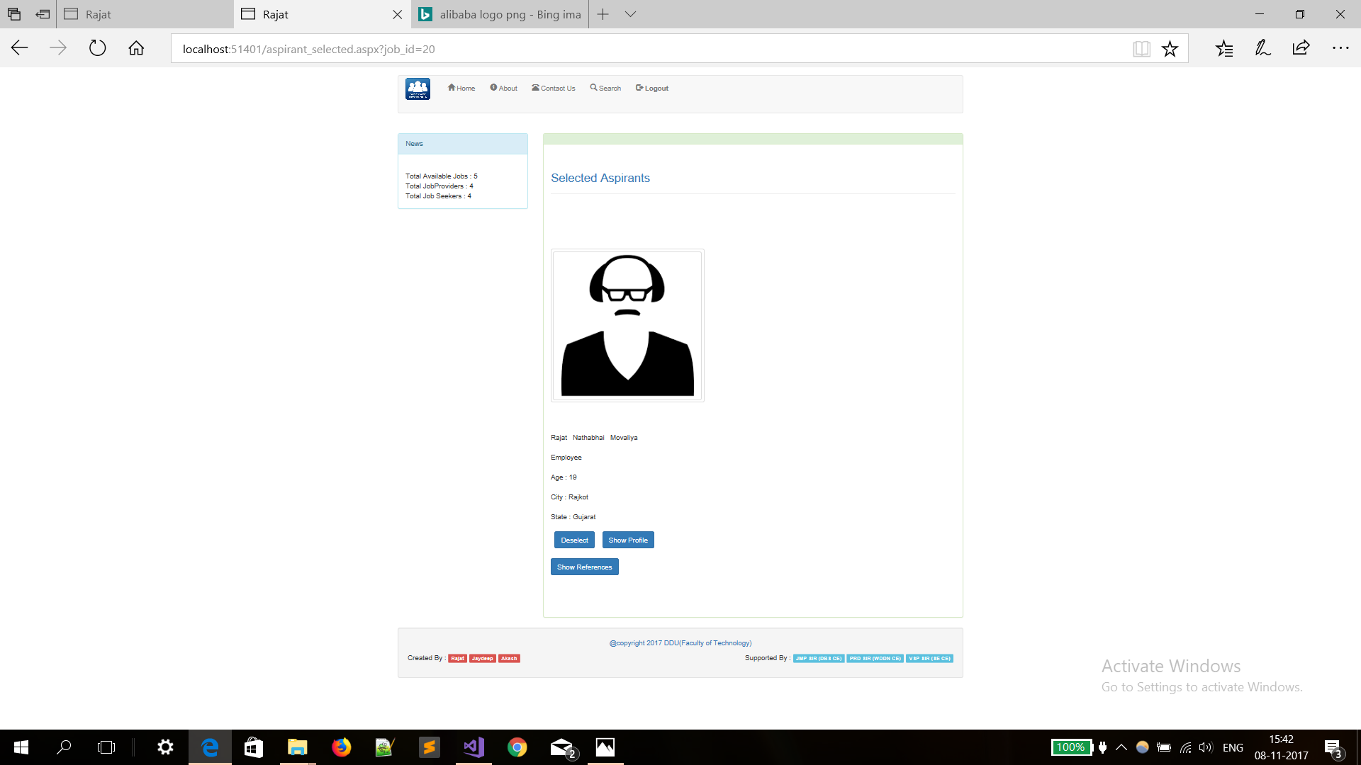

Slide 49
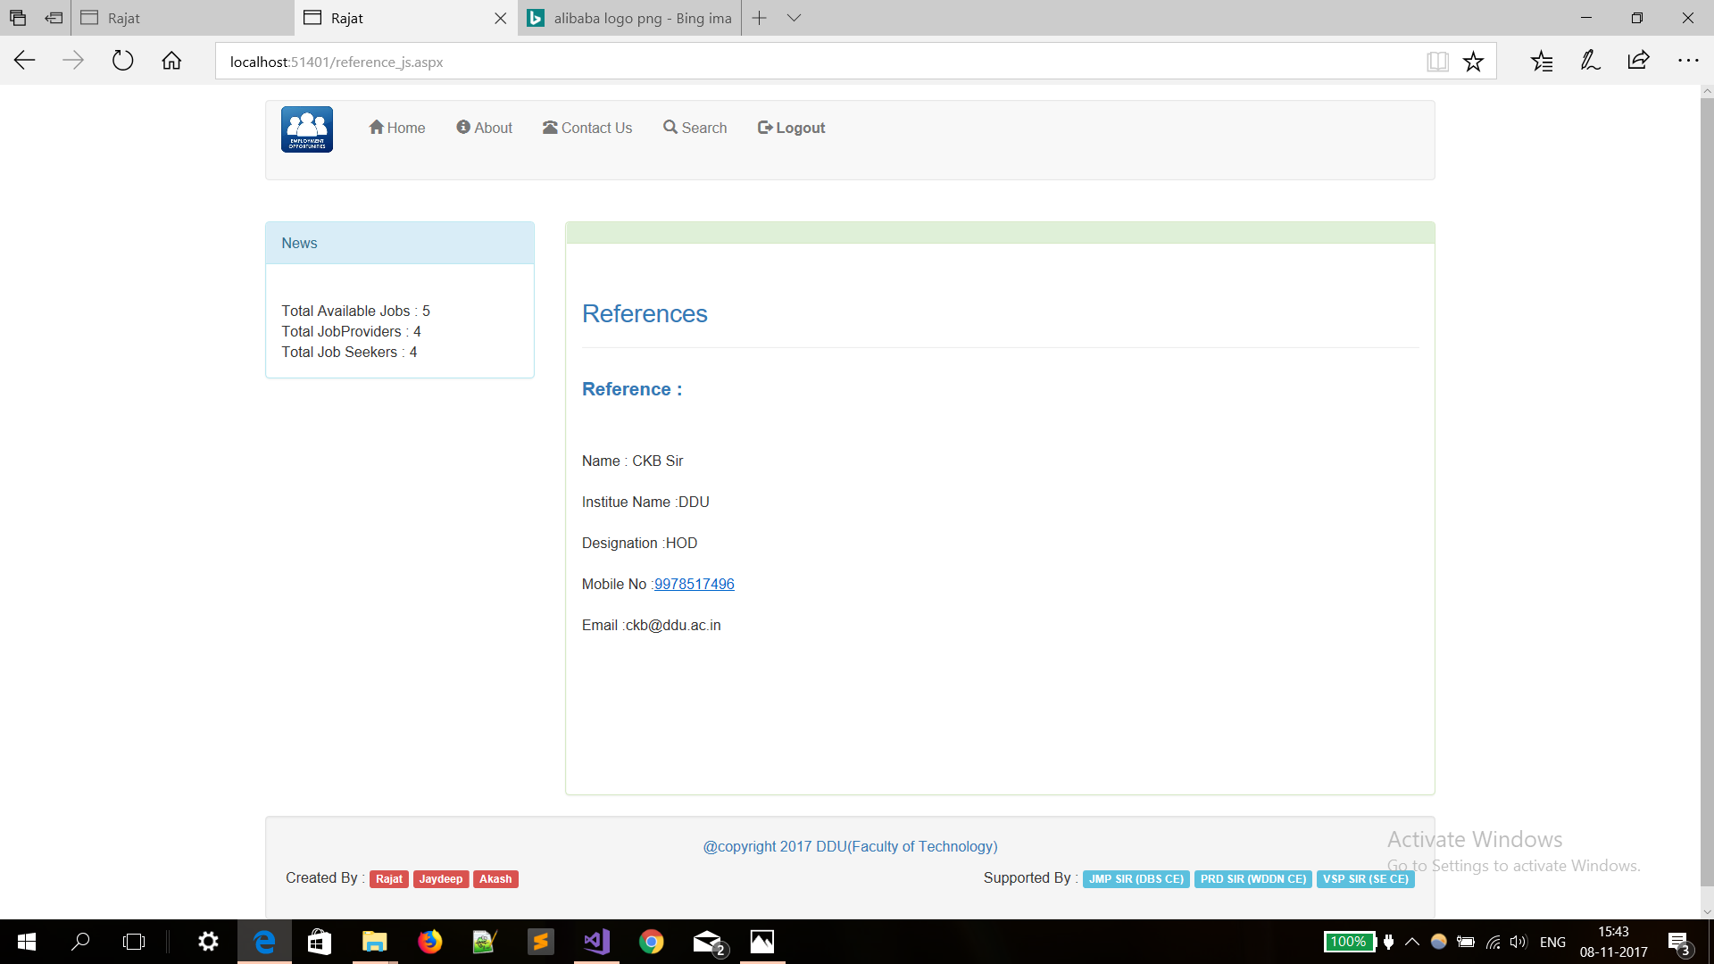

Slide 50
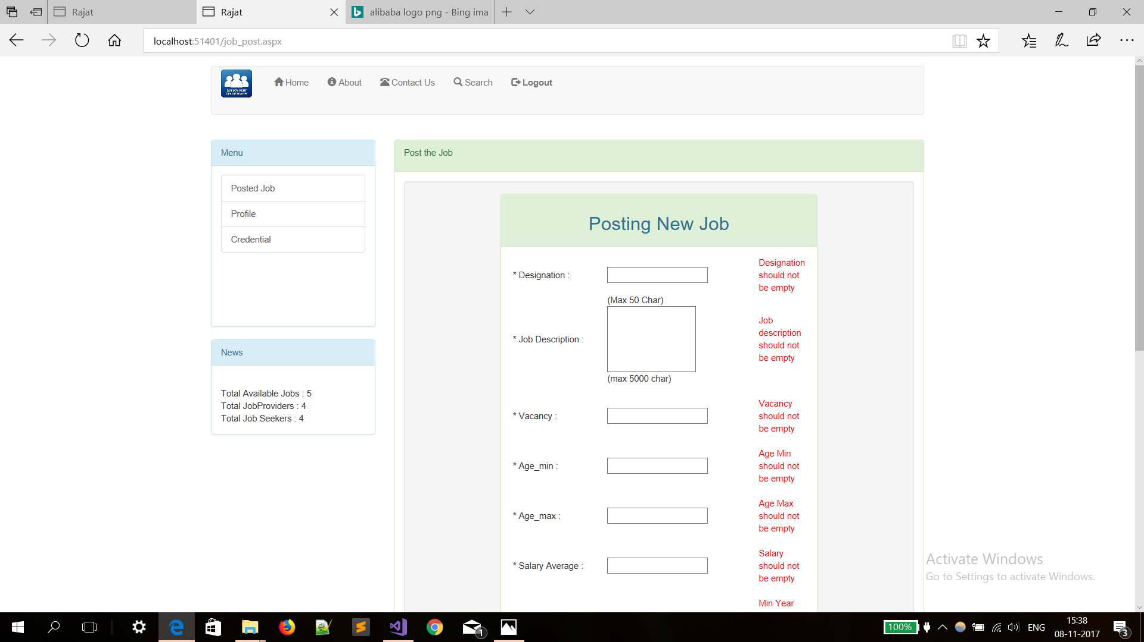

Slide 51
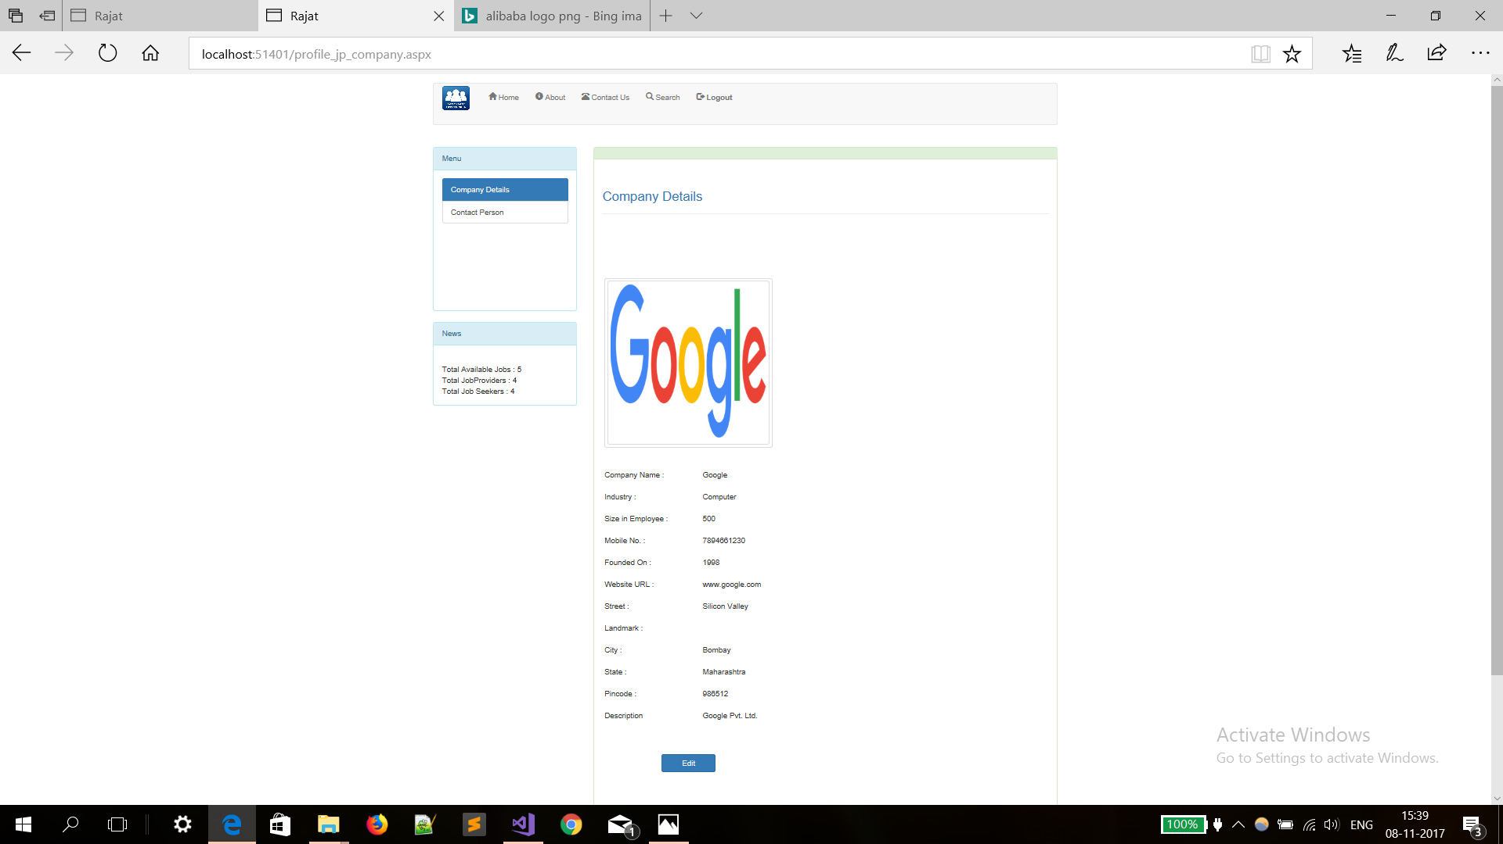

Slide 52
For Job Seekers

Slide 53
Dashboard

Slide 54
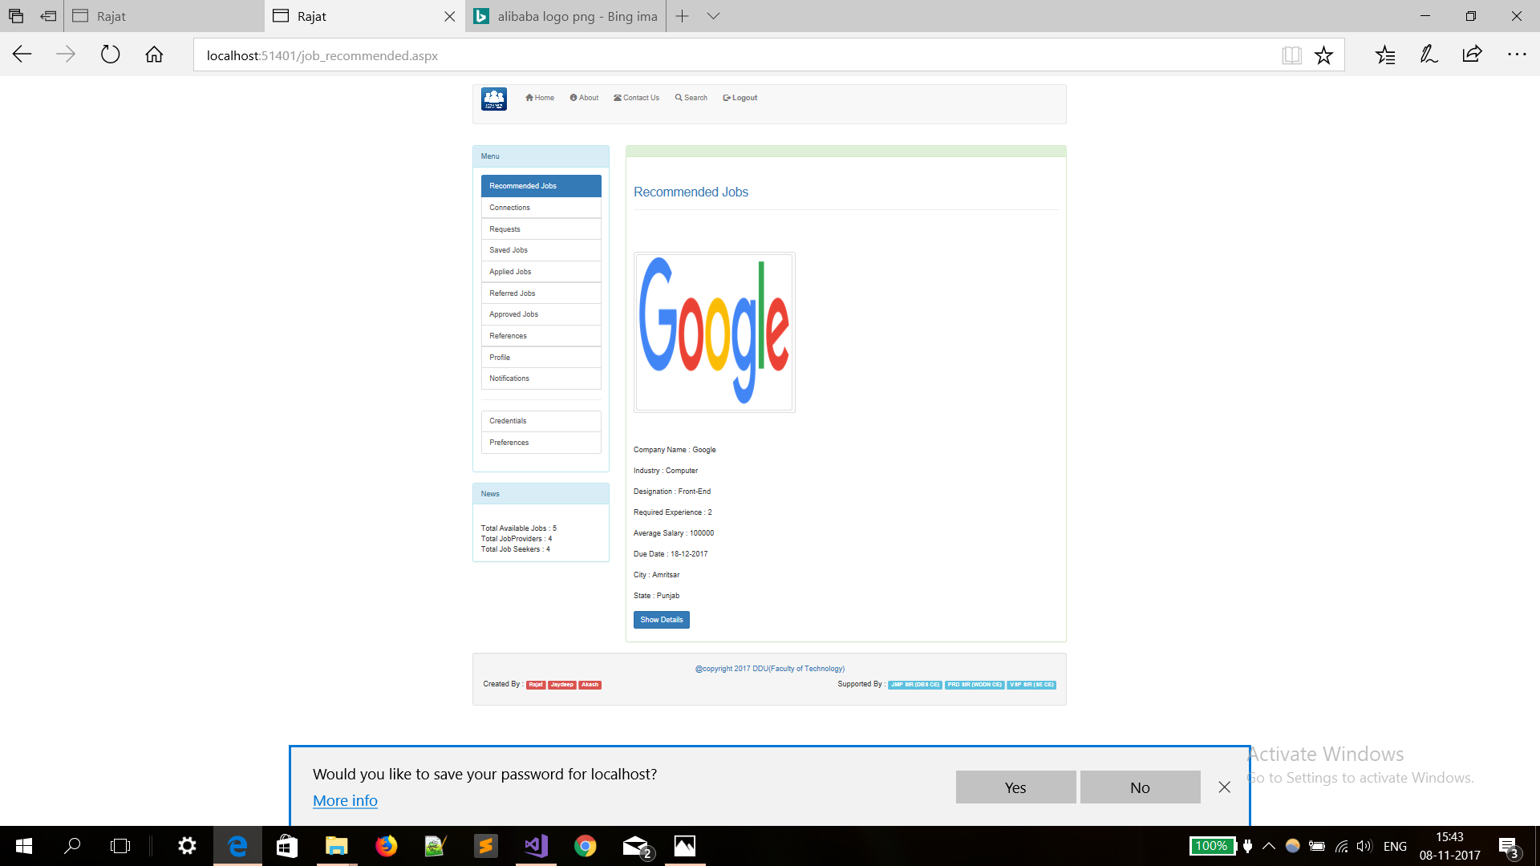

Slide 55
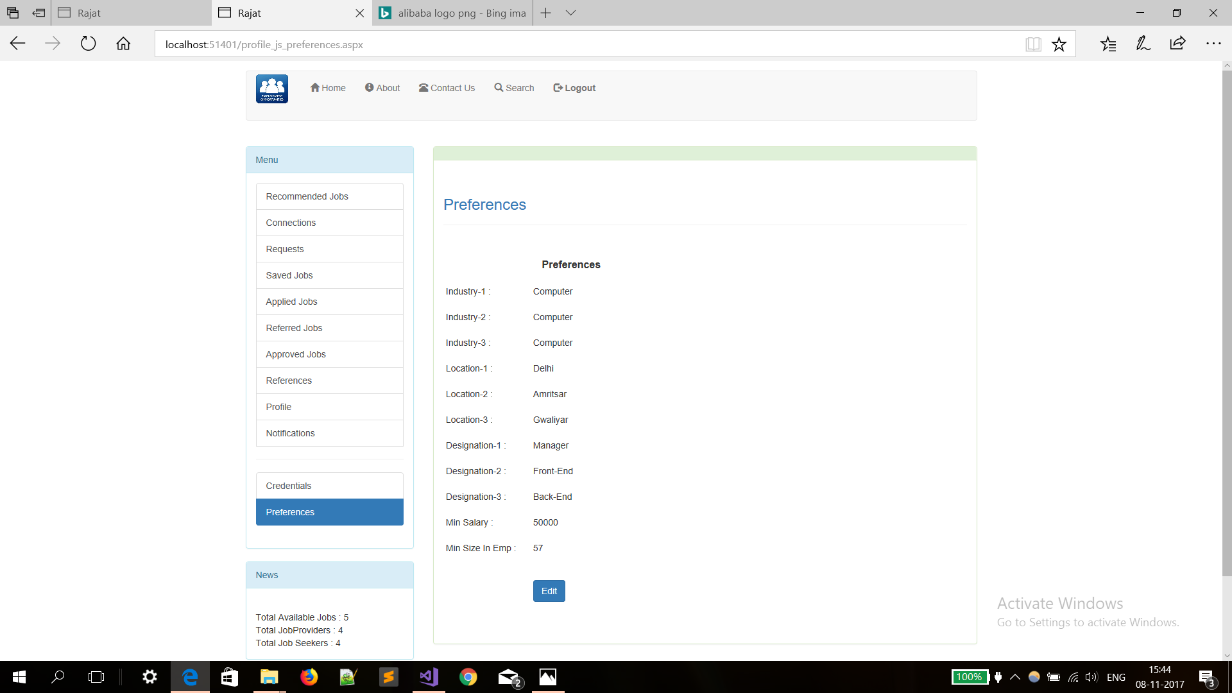

Slide 56
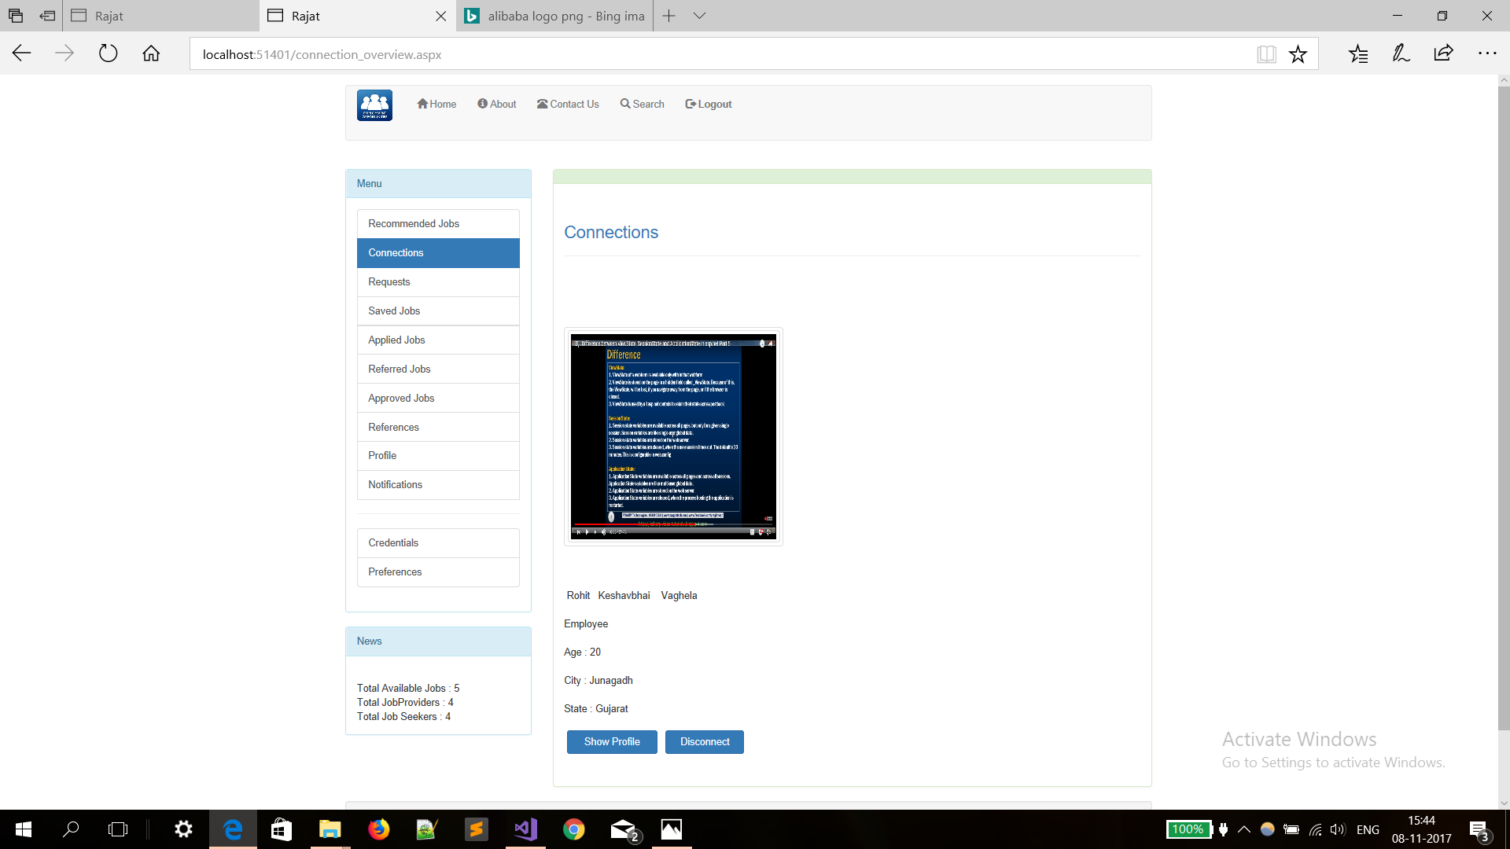

Slide 57
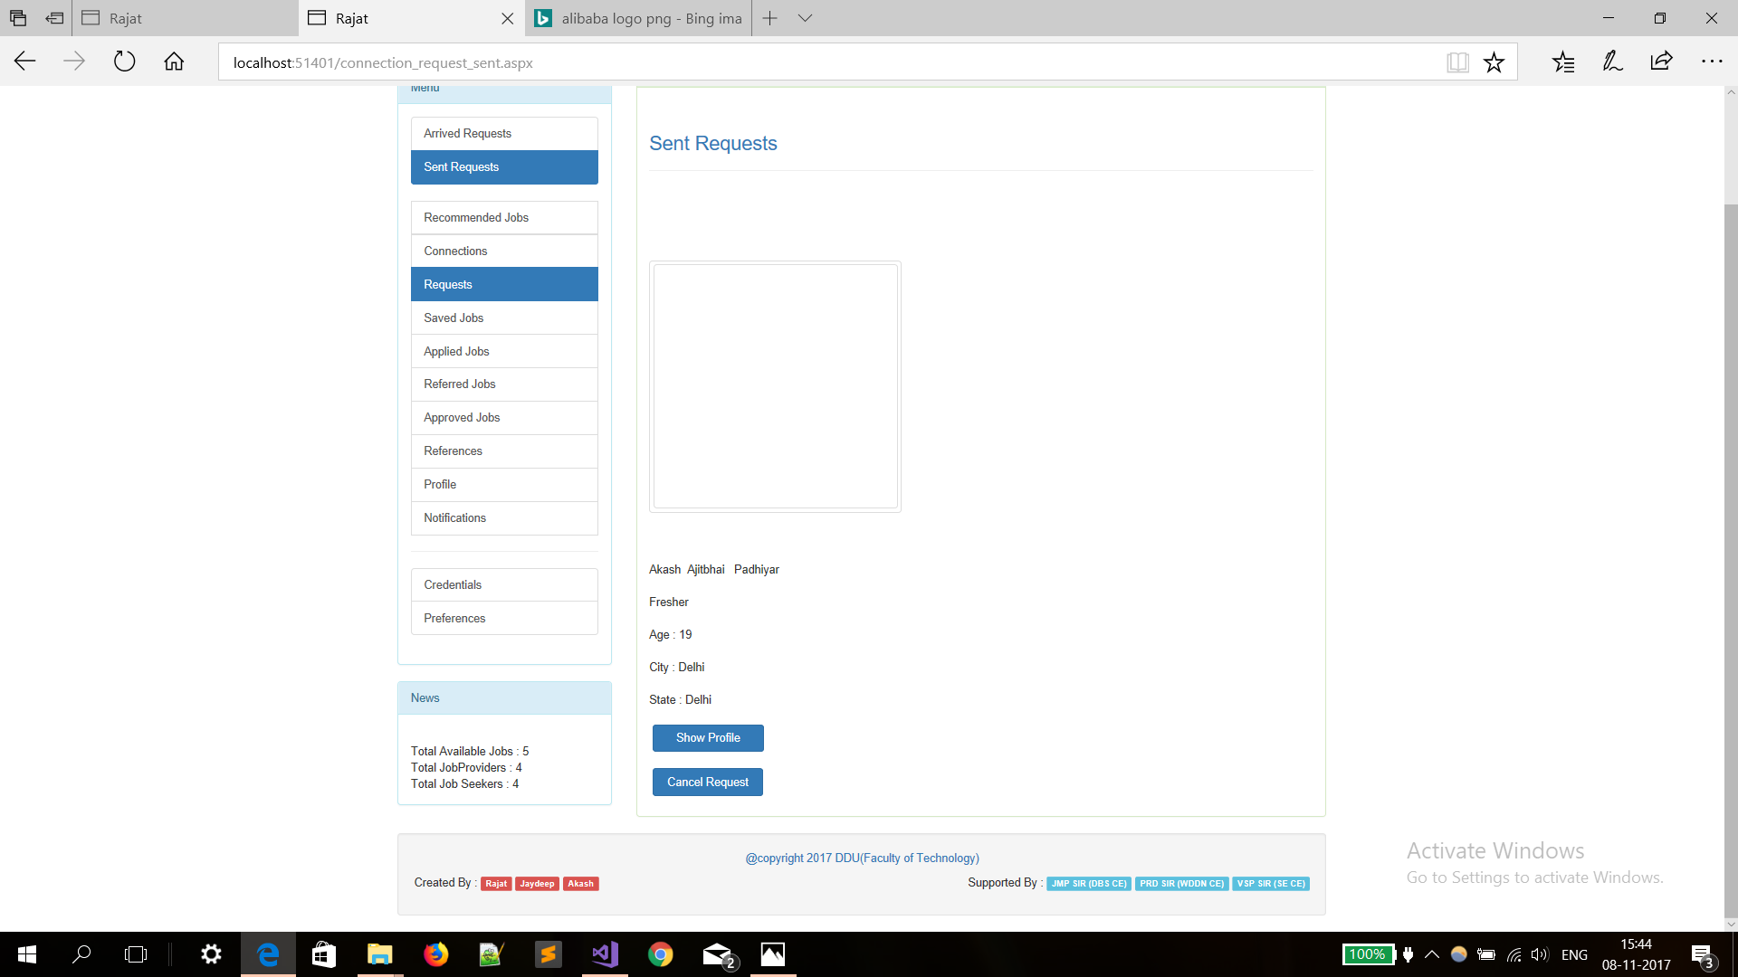

Slide 58
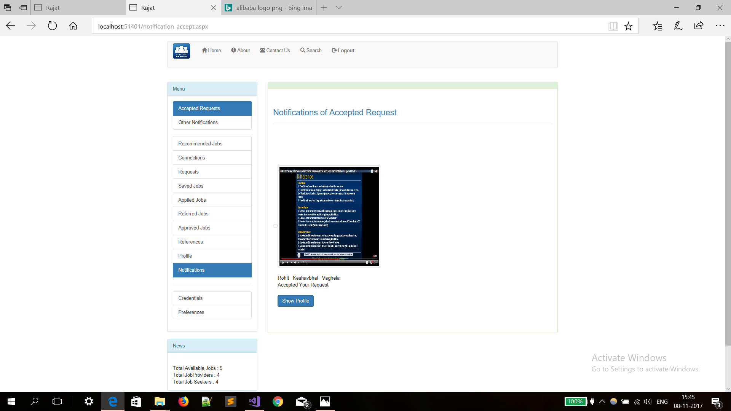

Slide 59
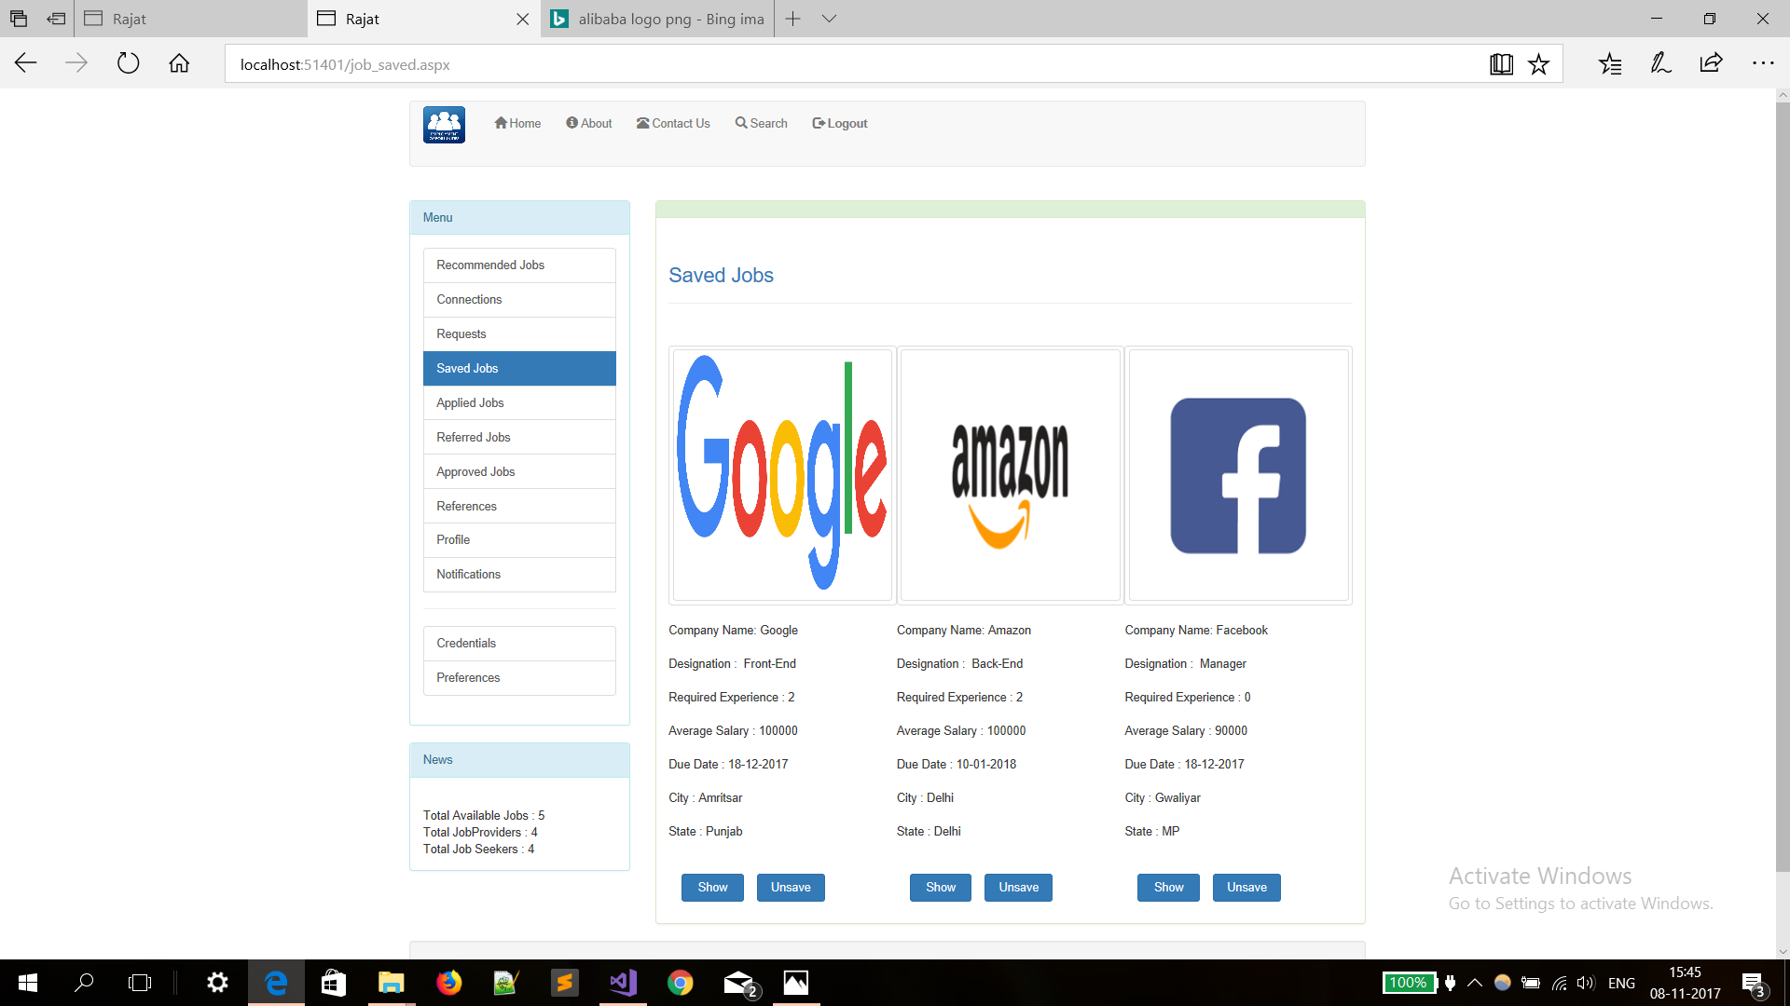

Slide 60
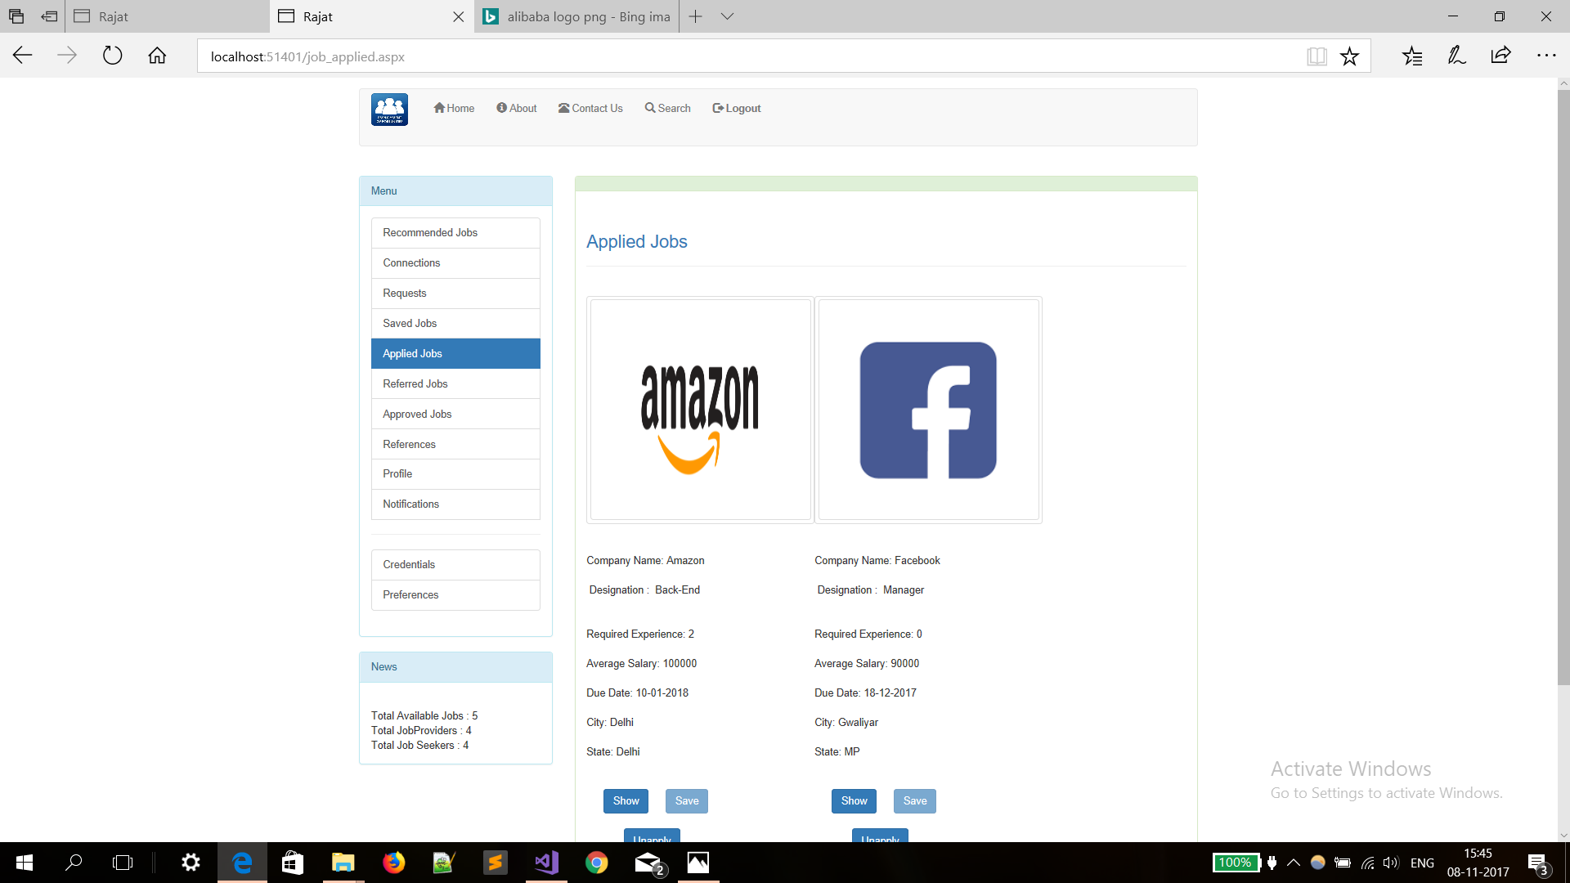

Slide 61
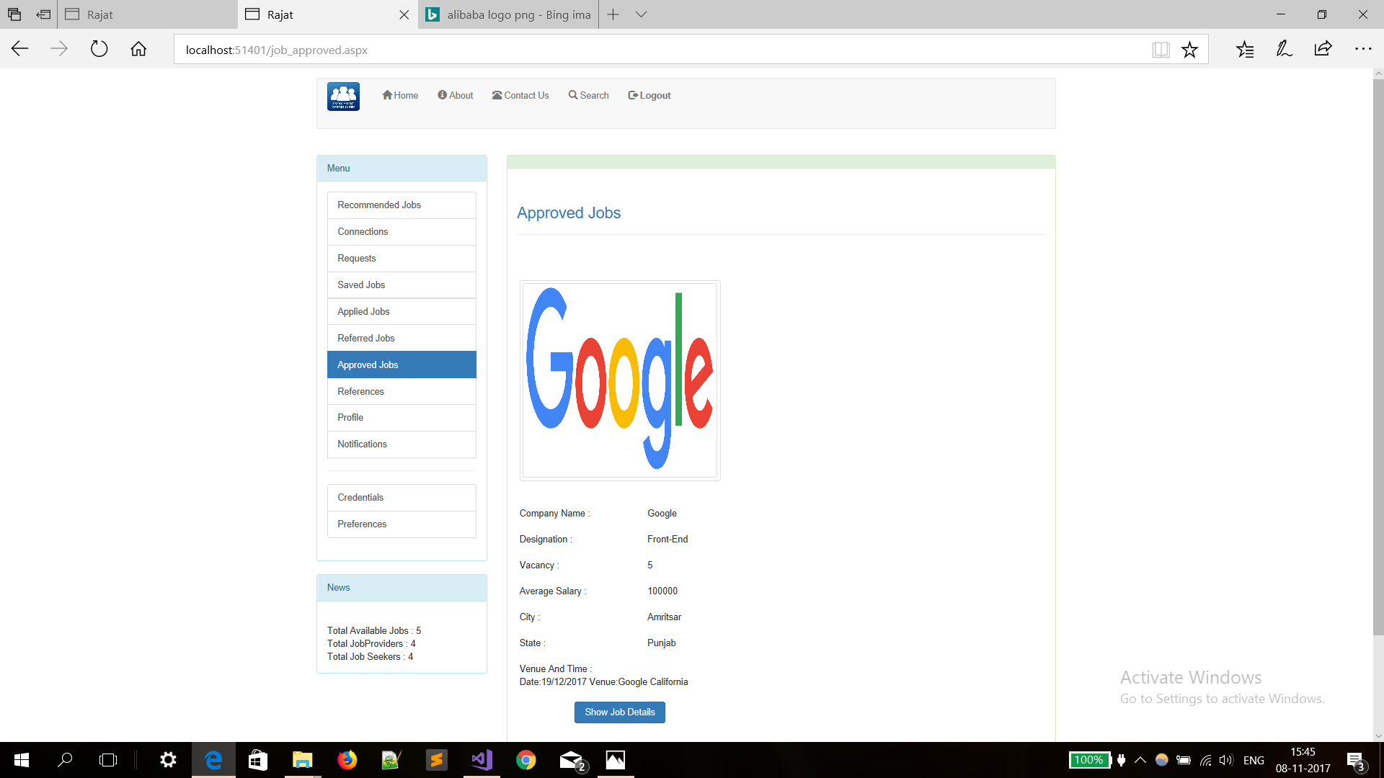

Slide 62
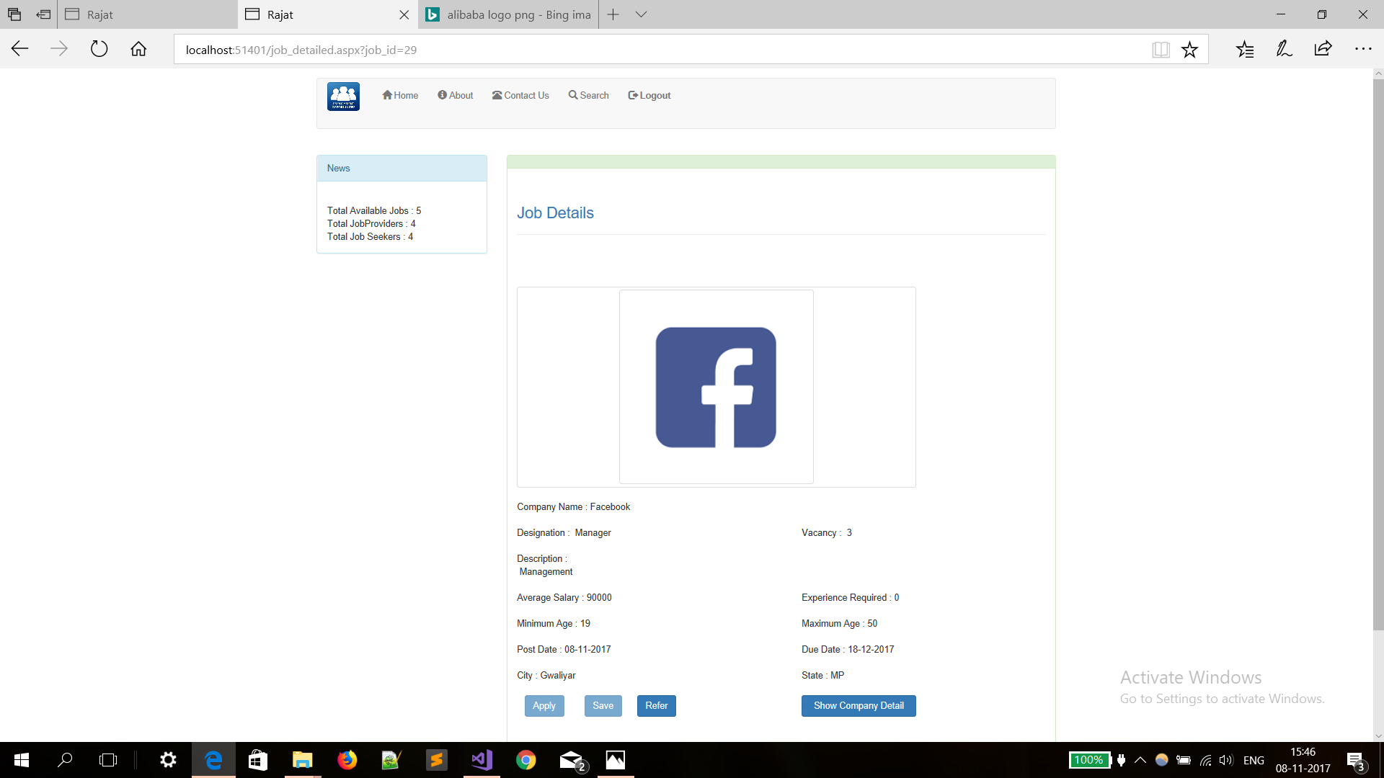

Slide 63
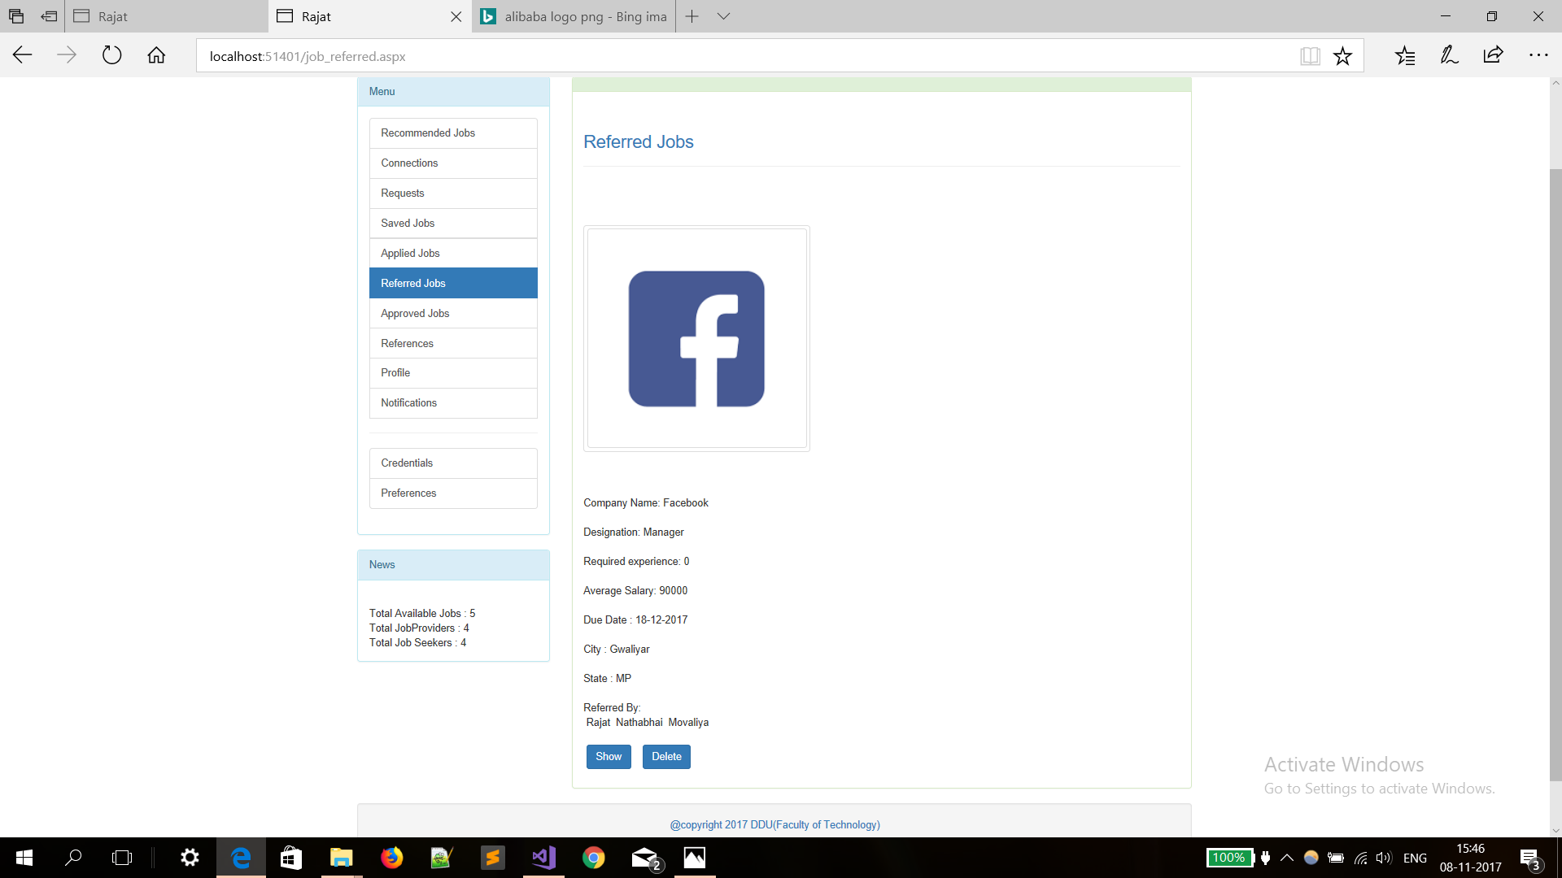

Slide 64
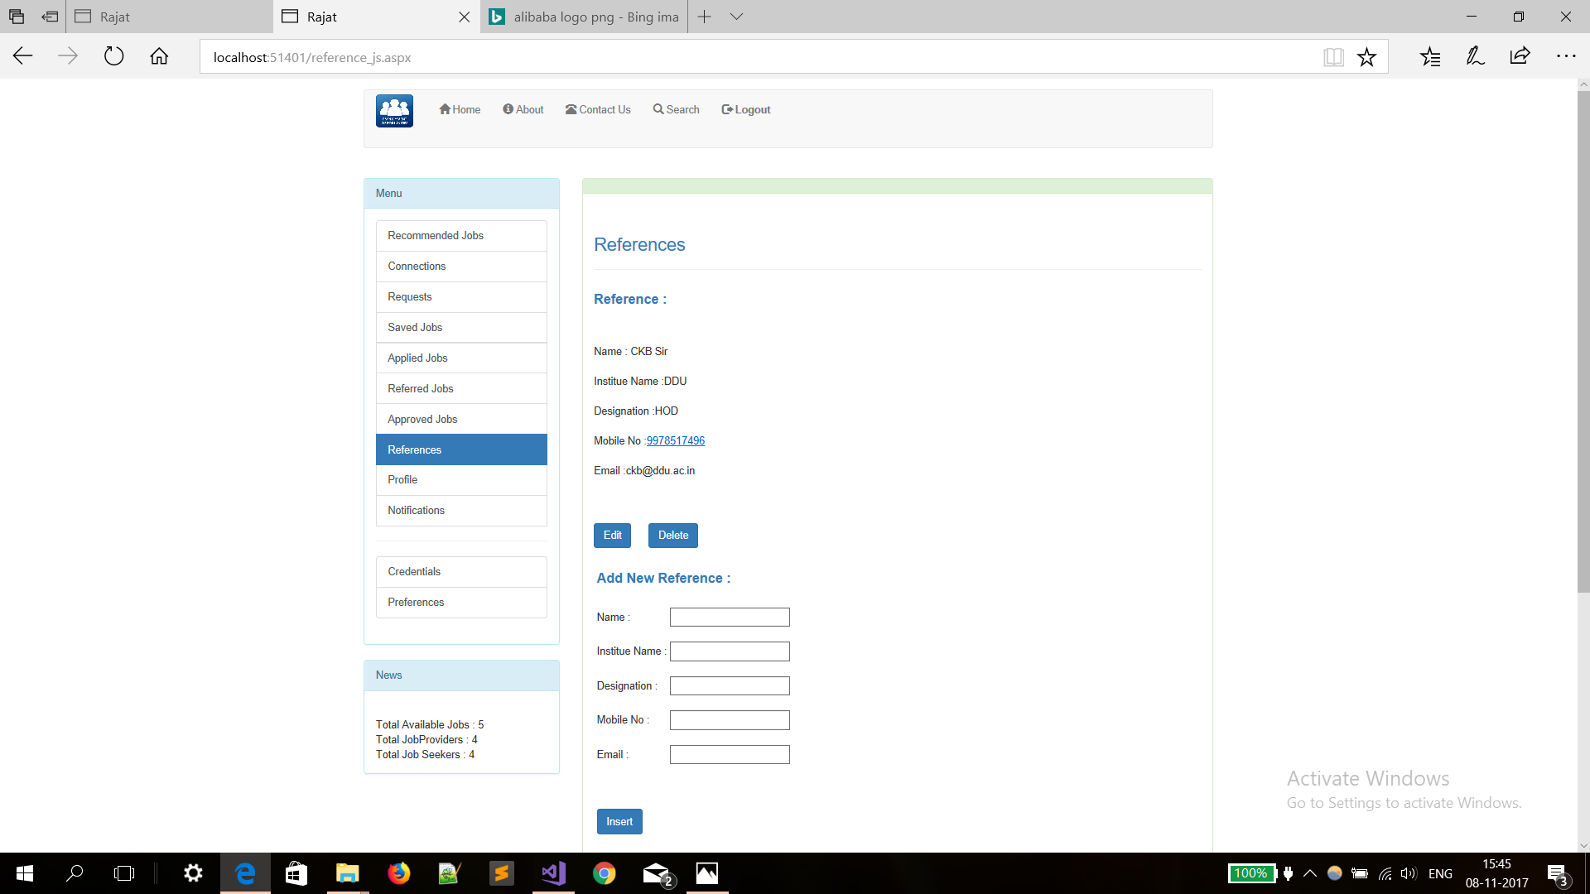

Slide 65
The End

